Slide 1
I-39/90 RECONSTRUCTION
BELOIT’S PERSPECTIVE
MICHAEL F. FLESCH, P.E.
CITY ENGINEER
fleschm@beloitwi.gov

Slide 2
PARTNERS
WISCONSIN DOT
CITY OF BELOIT
AREA BUSINESSES

Slide 3
BELOIT’S CONCERNS
Access- Vehicles and Pedestrian
Loss of Vehicles Entering the City
Intersection Controls
Alternative Routes

Slide 4
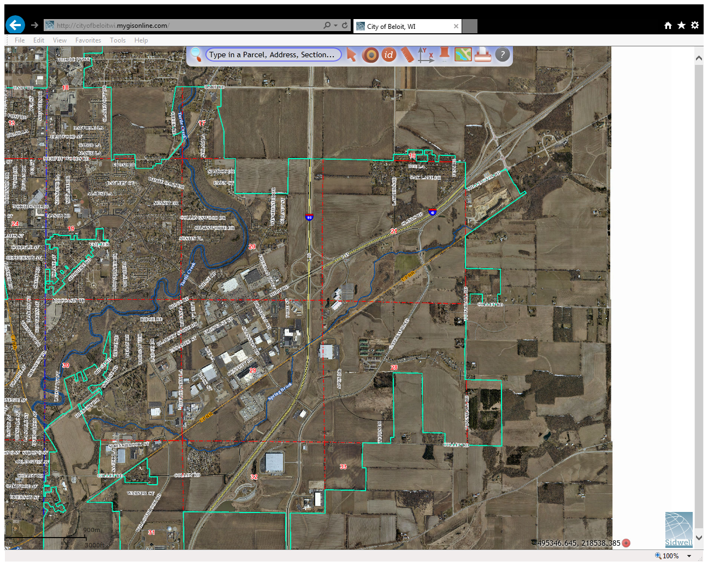
ACCESS

Slide 5
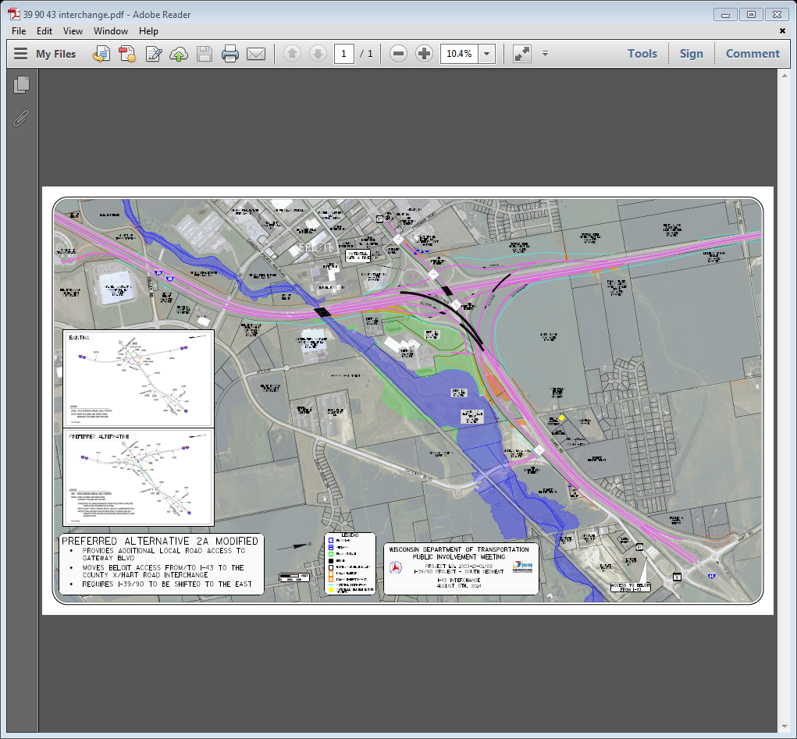
ACCESS SOLUTION

Slide 6
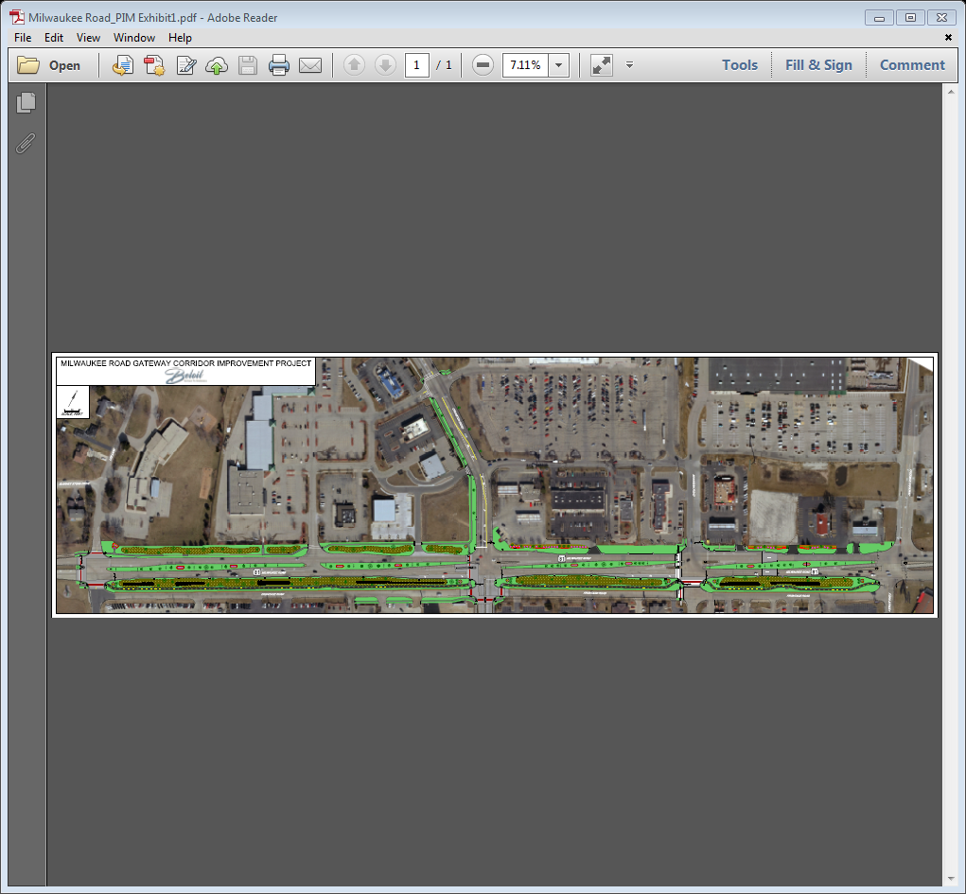
BIKE/PEDESTRIAN ACCESS

Slide 7
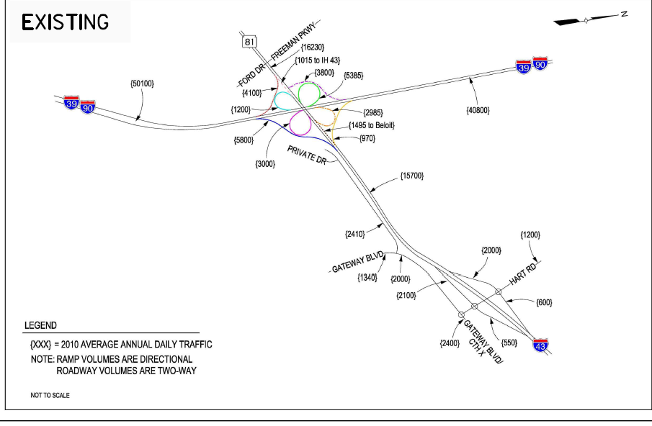
TRAFFIC DATA

Slide 8
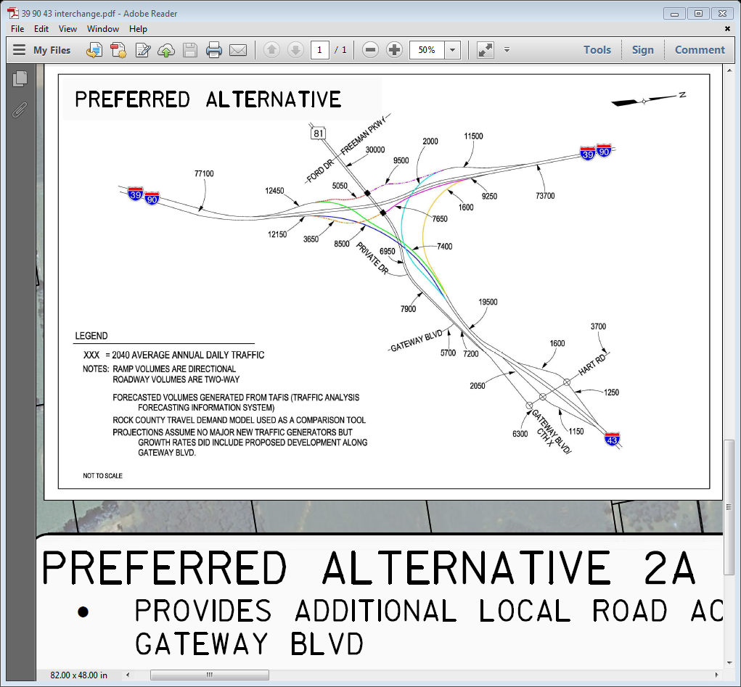
TRAFFIC DATA

Slide 9
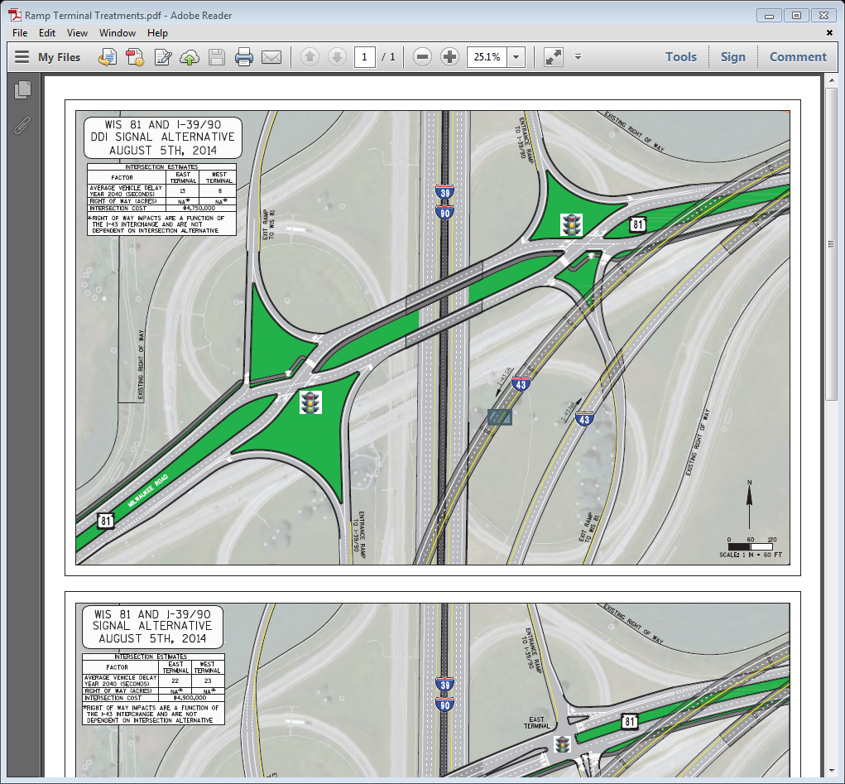

Slide 10
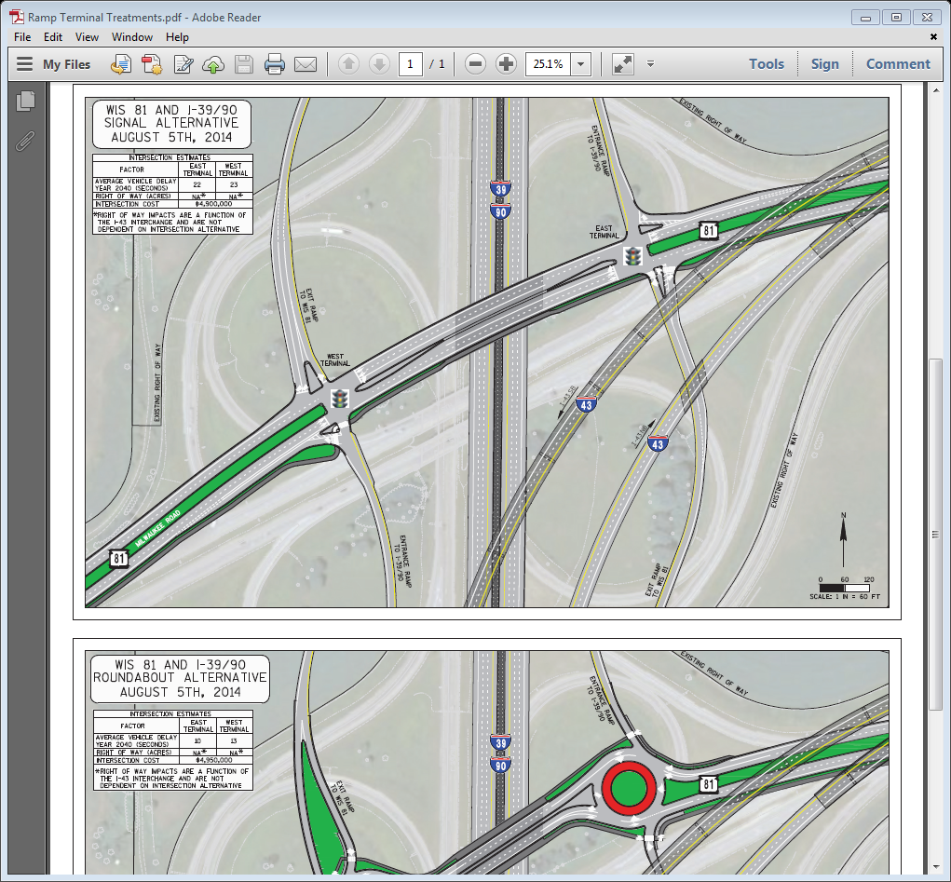

Slide 11
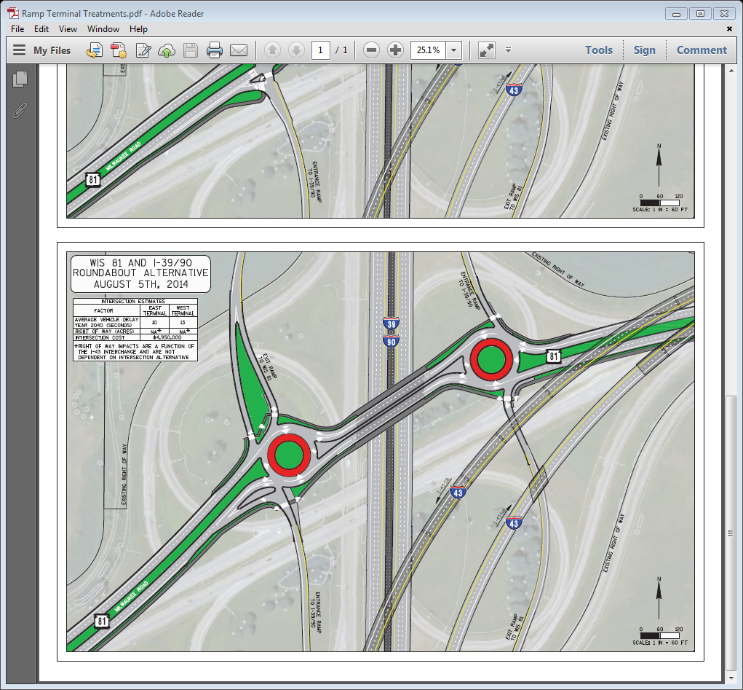

Slide 12
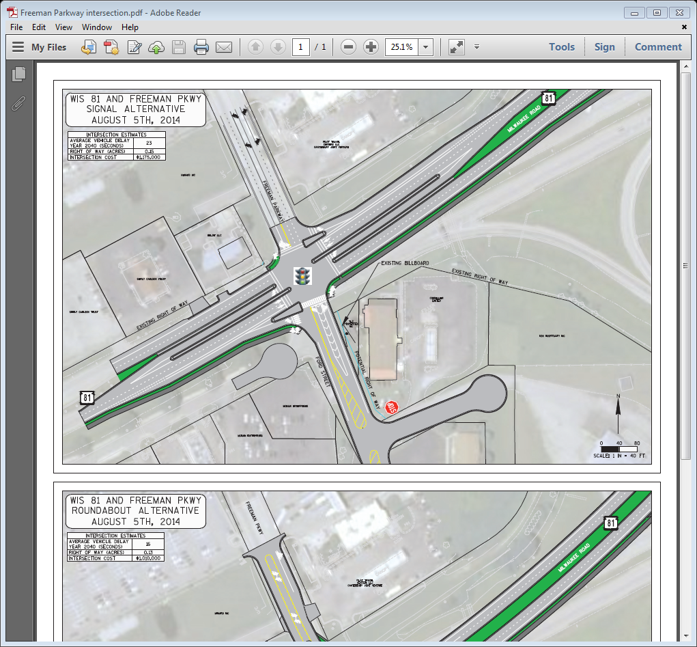

Slide 13
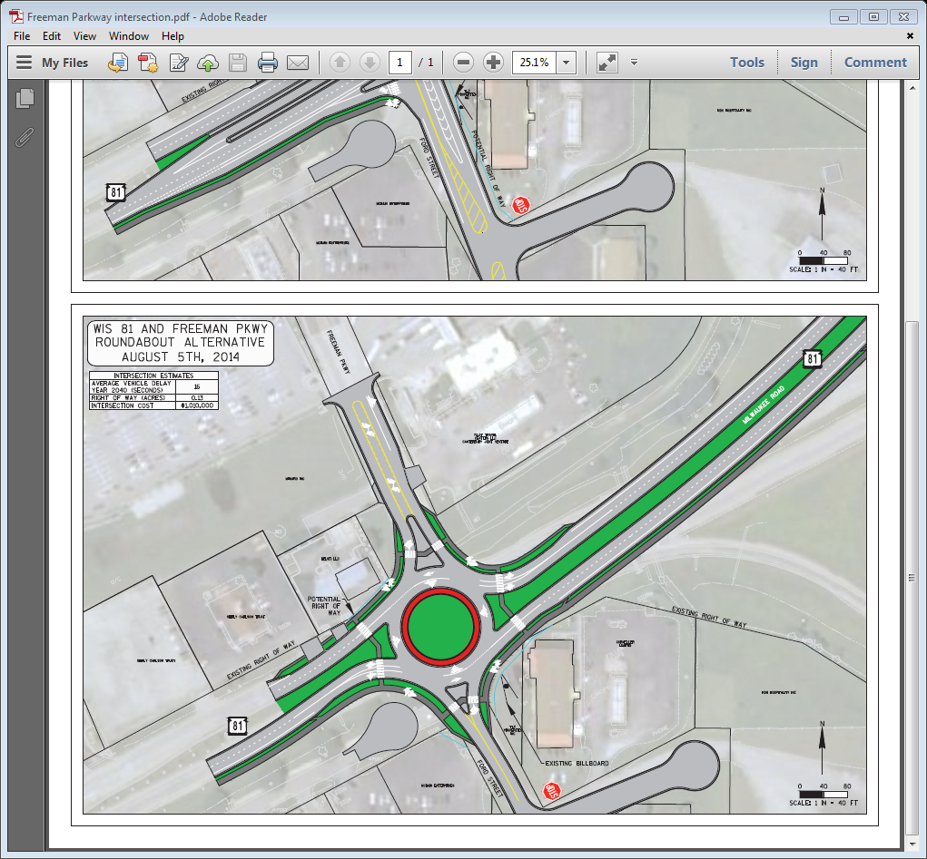

Slide 14
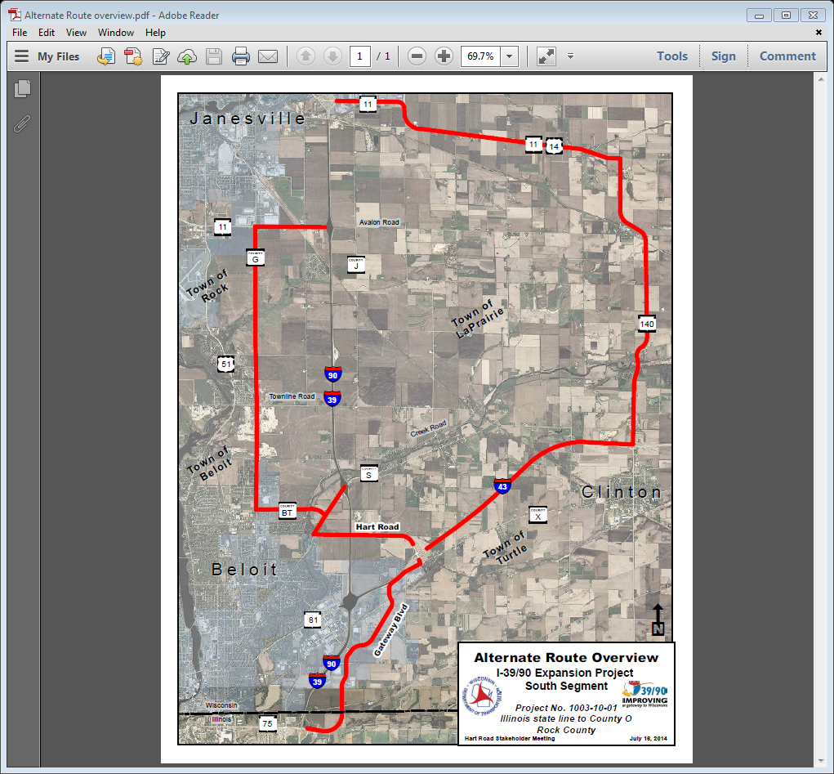

Slide 15
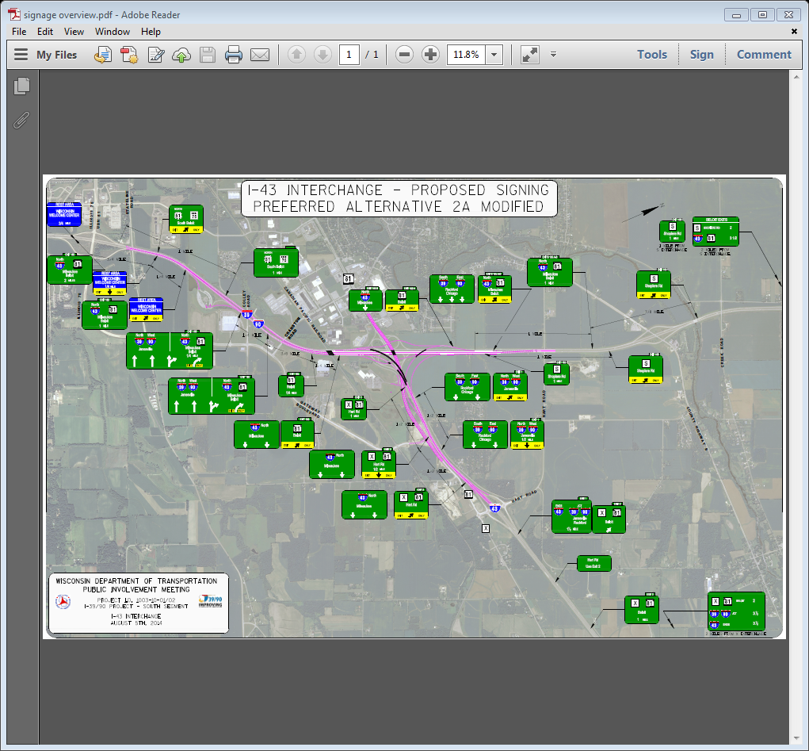

Slide 16
LESSONS LEARNED
Work with the DOT …Attend the meetings
Let the DOT know what the community needs and why
The wheels of government move slowly

