Slide 1
La Crosse Area
Truck Freight Network
Tom Faella, Director, LAPC
Wisconsin MPO Conference
September 25, 2014

Slide 2
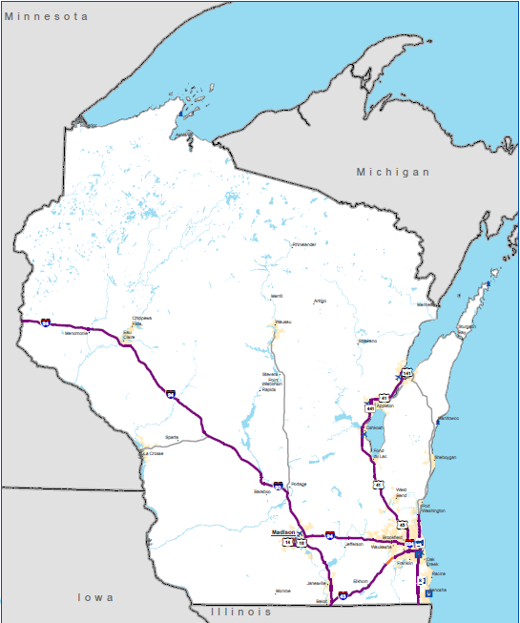
Purpose
Greater emphasis on freight planning in MAP-21
FHWA
  Highway Primary Freight Network
National Primary Freight Network

Slide 3
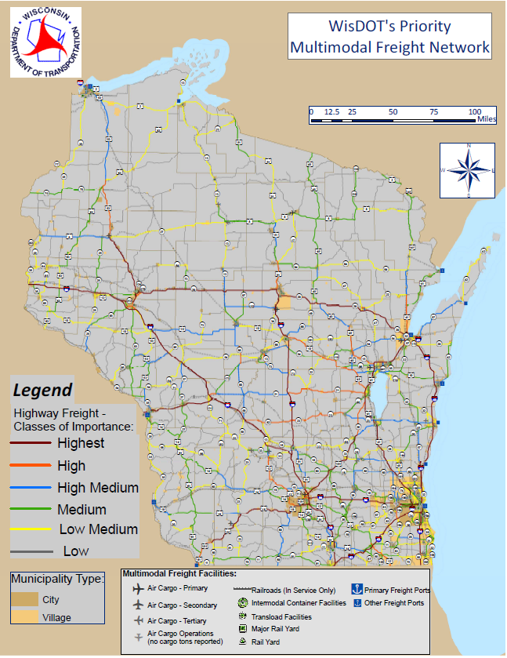
Wisconsin Freight Planning
Wisconsin Multimodal Freight Network

Slide 4
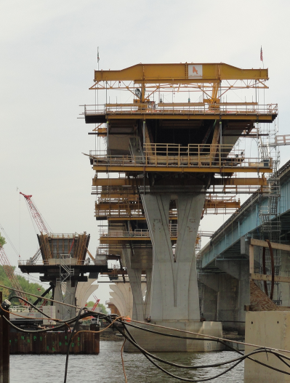
Minnesota Freight Planning
Statewide Freight System Plan
  June 2014-July 2015
Statewide Rail Plan (passenger and freight)
  June 2014-February 2015

Slide 5
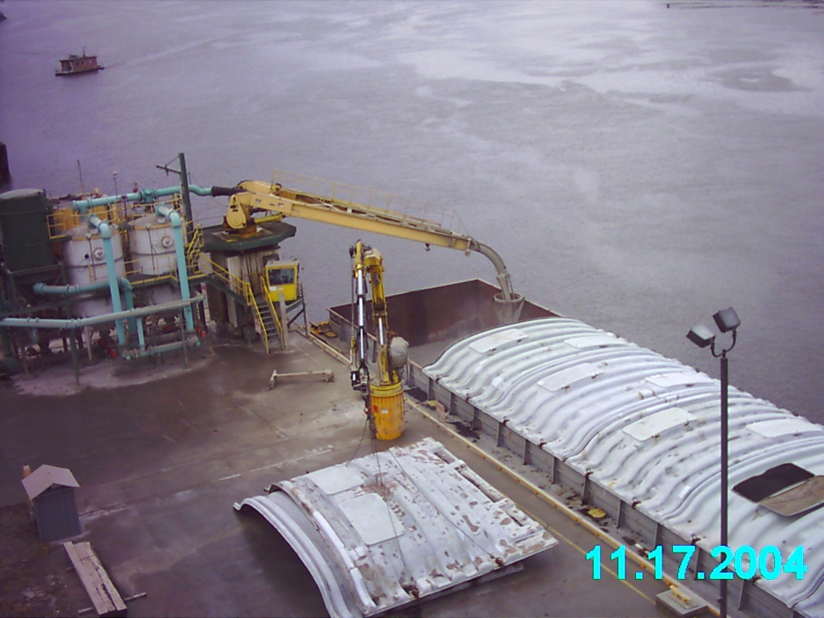
Local Freight Planning
Data analysis for 2015 metropolitan transportation plan update
  Economic vitality performance measure (originating tons)
  Multimodal freight
    Existing conditions
    Commodity flows
Planning for additional BNSF track through La Crosse

Slide 6
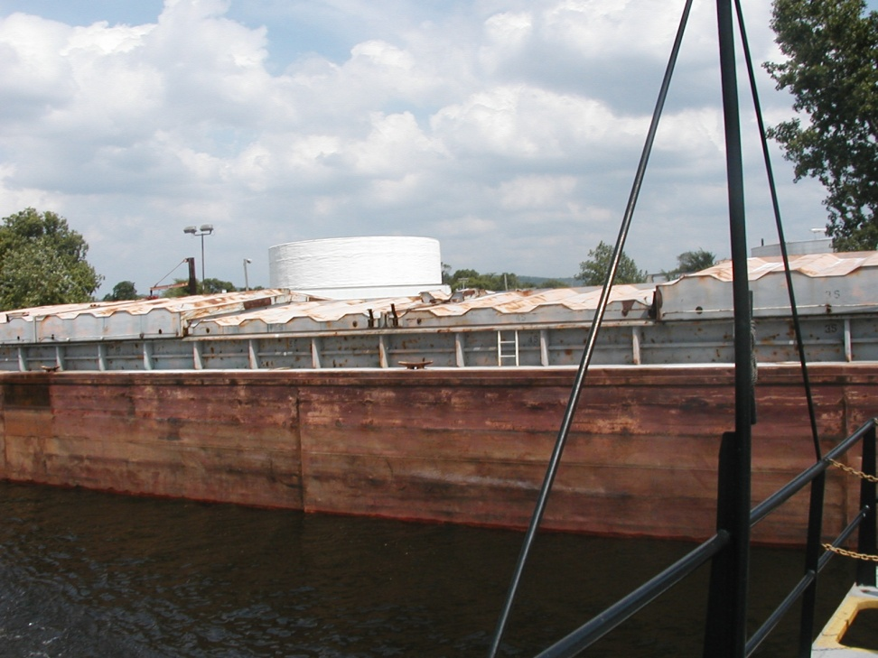
Local Freight Planning
Coulee Vision 2050
  Freight providers focus group
    Desire for designated truck routes through La Crosse
    Better signalization, coordination, and signage

Slide 7
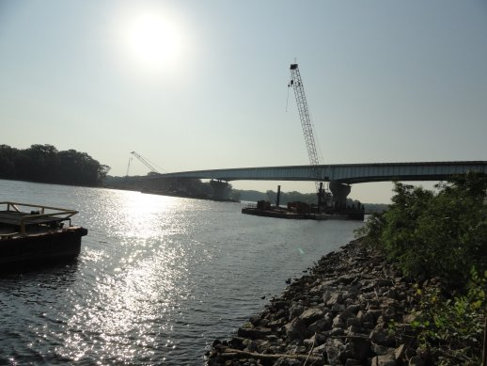
Local Freight Planning
TAC discussion
  Freight emphasis in CV2050 and MAP-21
  Designation to leverage possible future freight funding
  Recommended designating and mapping a truck freight network

Slide 8
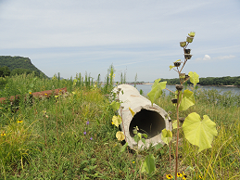
Local Freight Planning
Methodology
  Inputs
    National Highway System
    Locally designated truck routes
    OSOW routes
    National Priority Freight Network
    Wisconsin Multimodal Freight Network
    Industrial zoning
    Major intermodal freight sites
    Recommended routes on County highway system

Slide 9
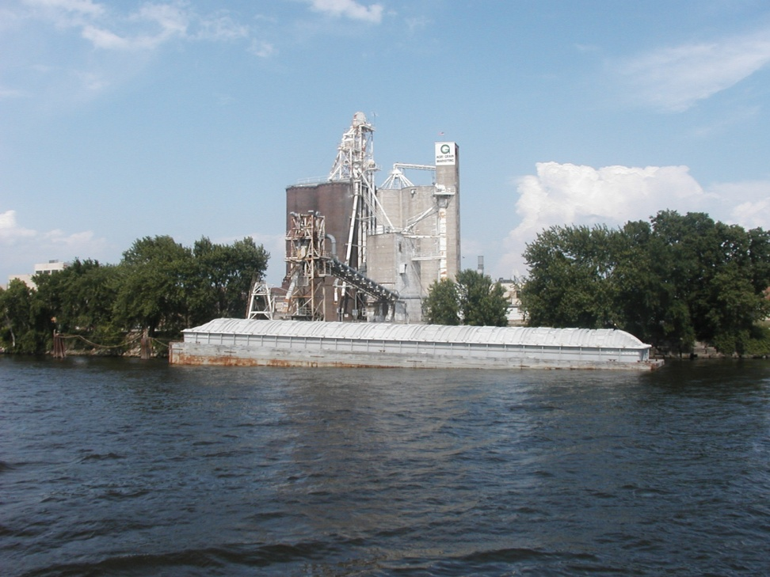
Local Freight Planning
Methodology (cont.)
  Mapping
    Created map of inputs
    Added connections between locally designated routes and state/federal routes
    Designated additional roads for access to industrial areas and intermodal sites
  Feedback
    MnDOT
    WisDOT
    La Crosse County

Slide 10
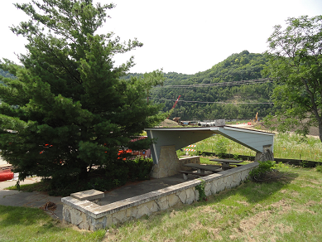
Next Steps
Distribute to stakeholders for review in October
Present to TAC in November
Incorporate into MTP

Slide 11
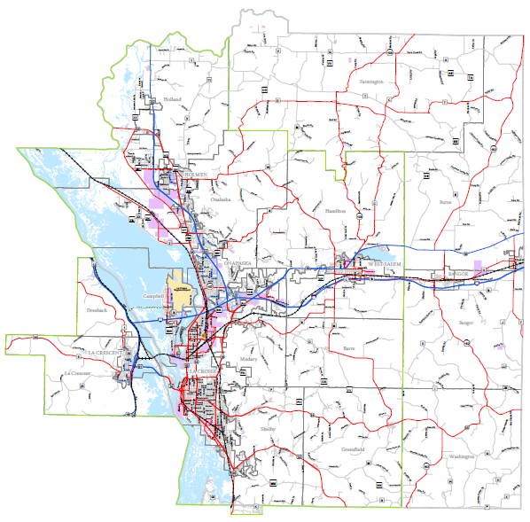
La Crosse Area Truck Freight Network

Slide 12
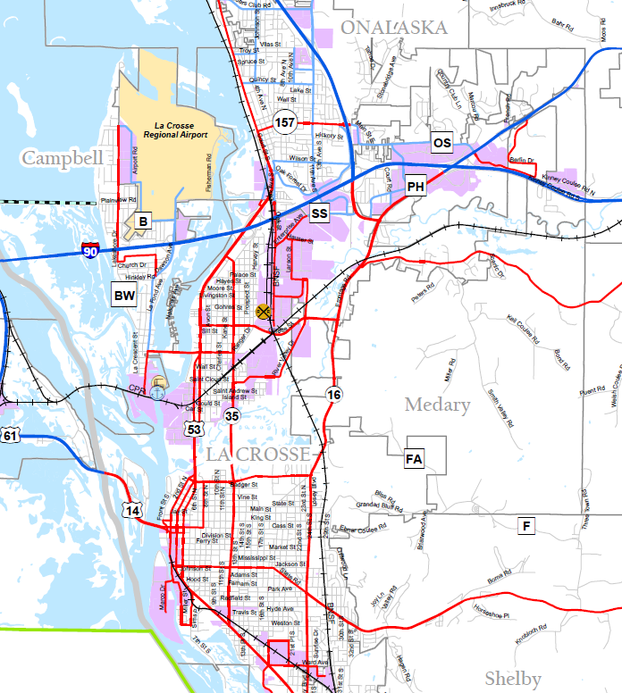
La Crosse Area Truck Freight Network

Slide 13
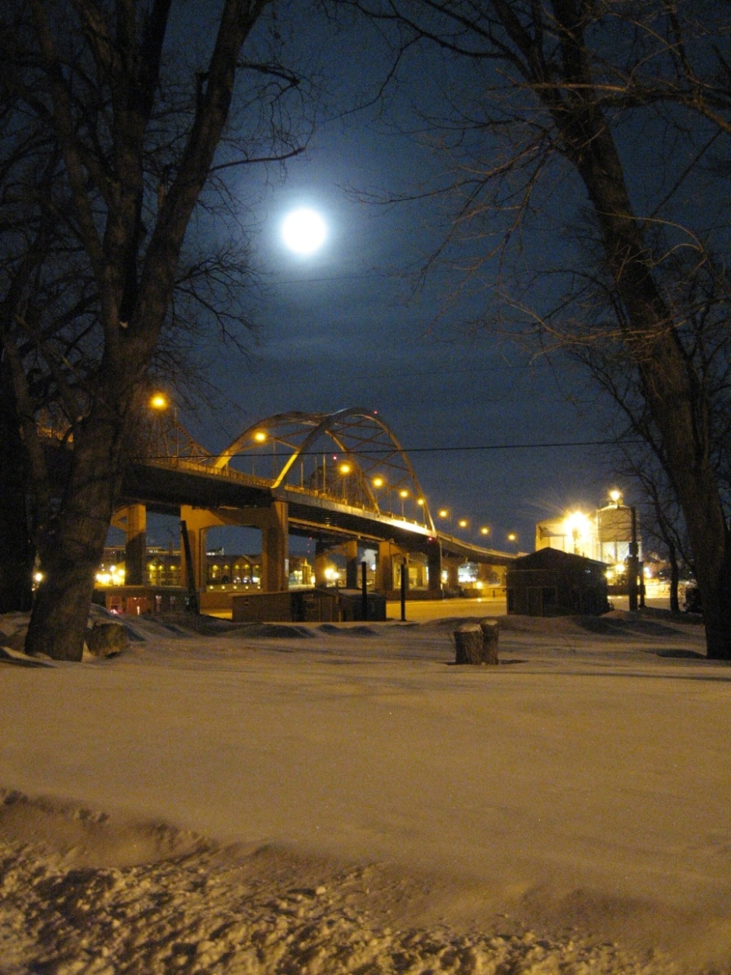
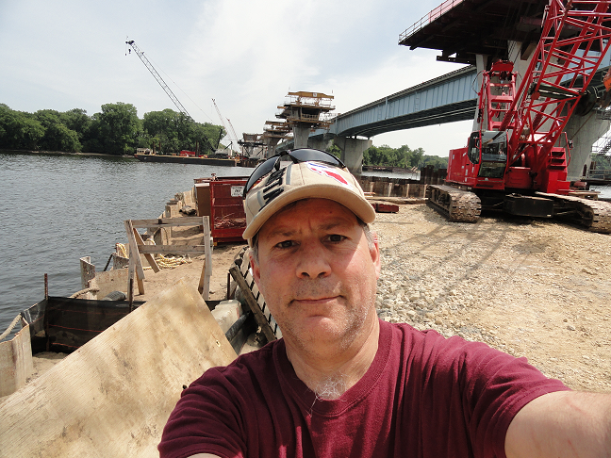
So there you have it….
www.LAPC.org
Cameron Street Bridge by Greg Pates
Thank you!!!!!!

