Slide 1
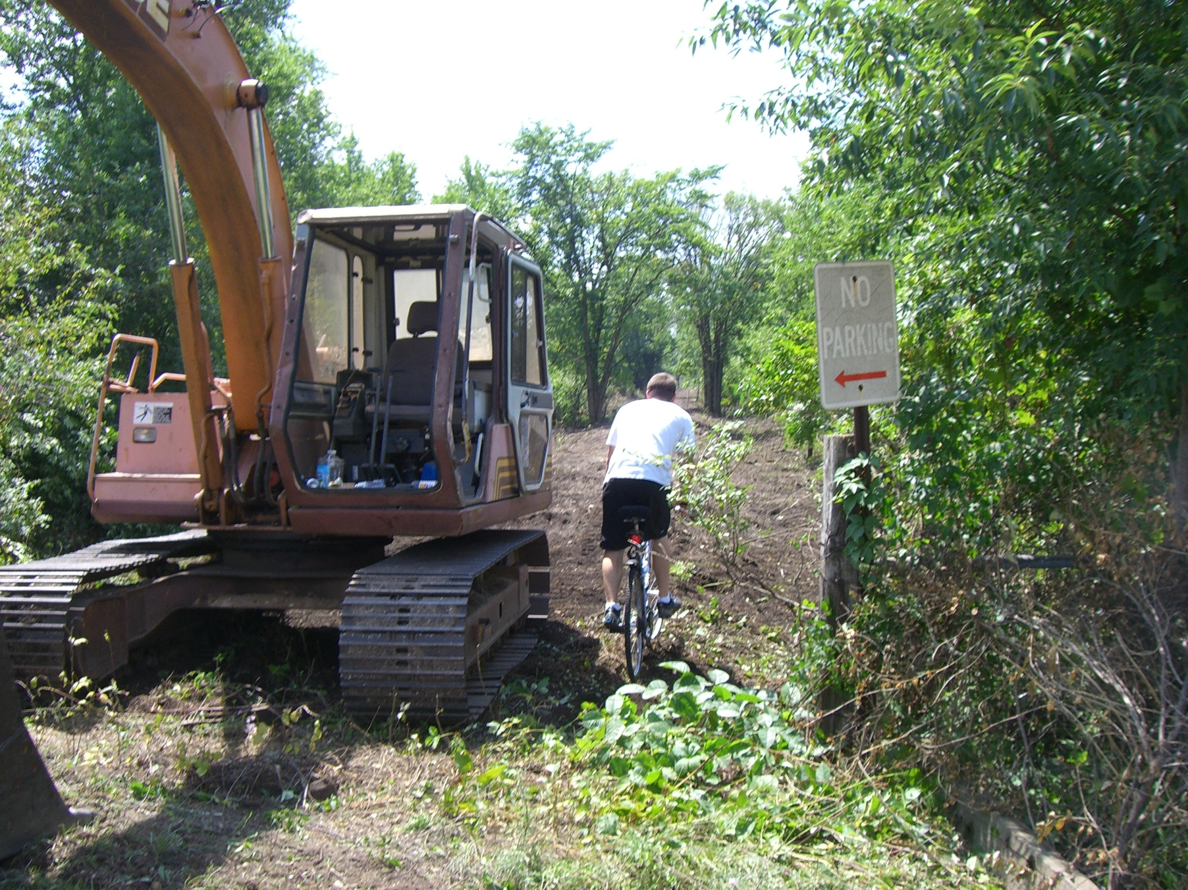
Rock Trail Coalition
Trails Update September 24, 2014

Slide 2
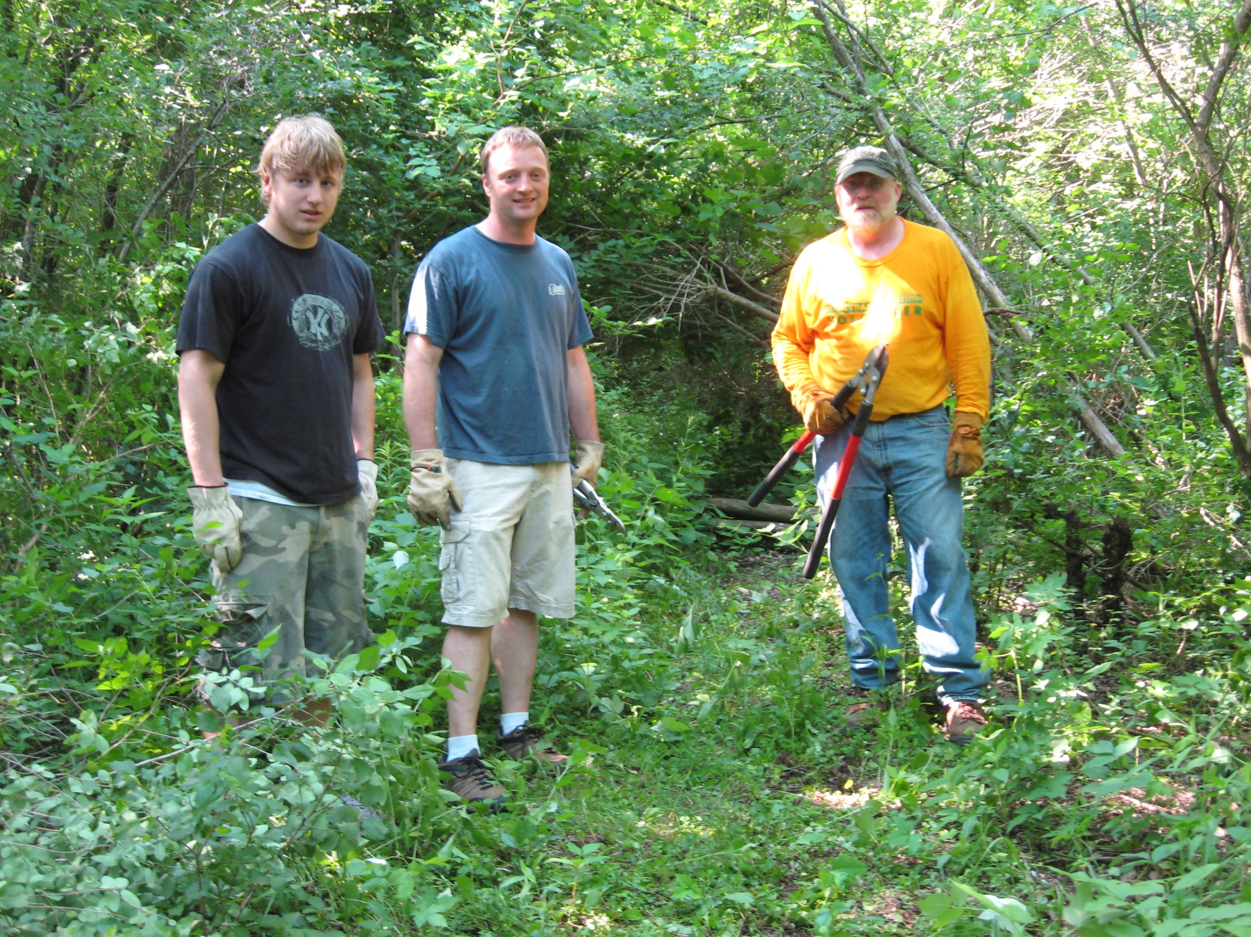

Slide 3
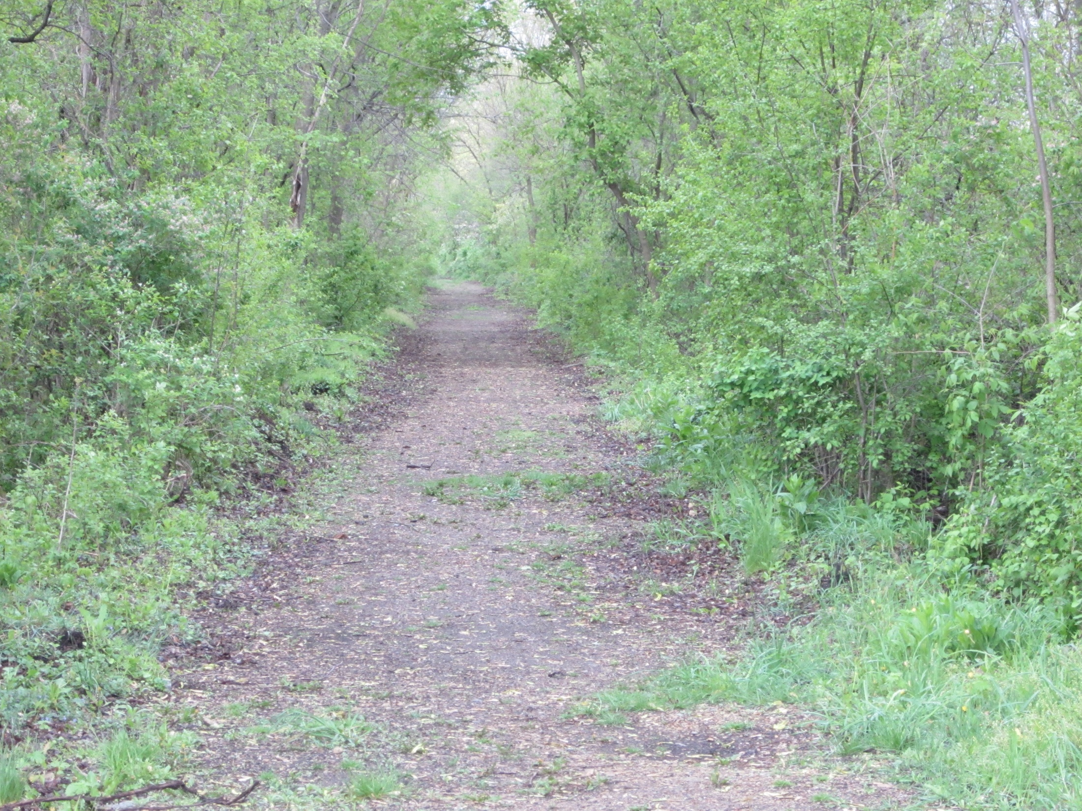

Slide 4
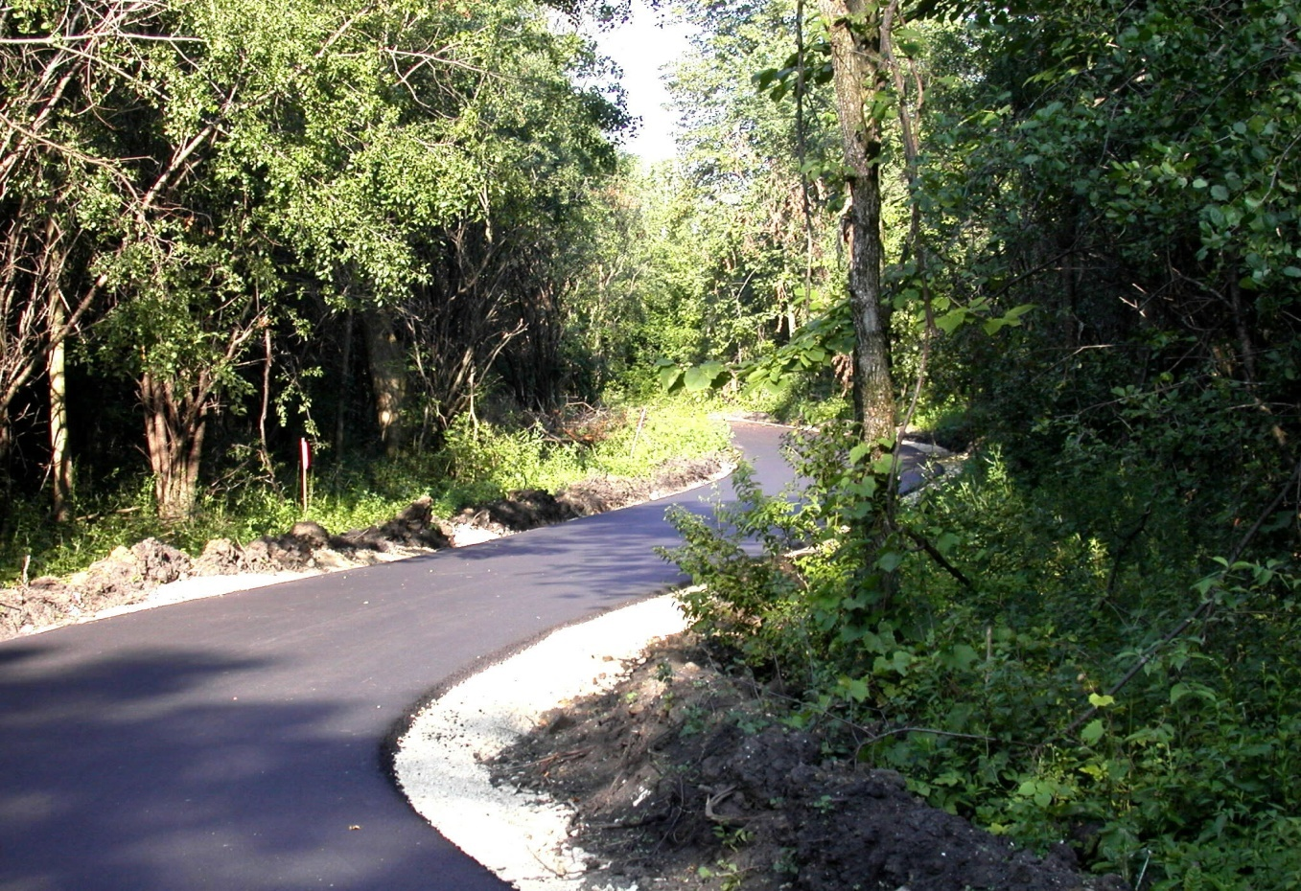

Slide 5
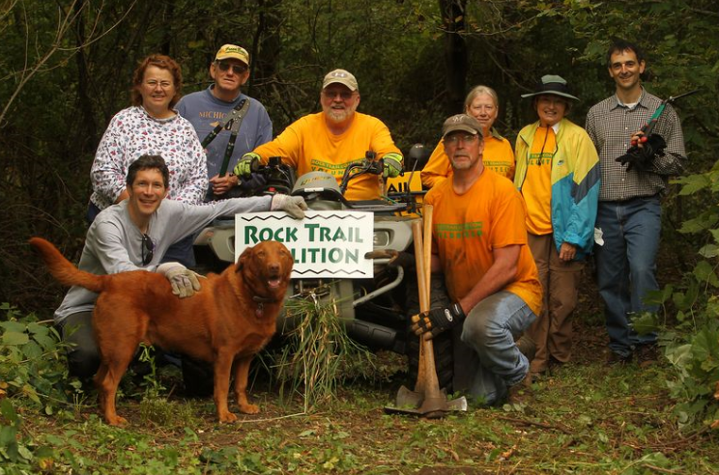
Rock Trail Work Parties

Slide 6
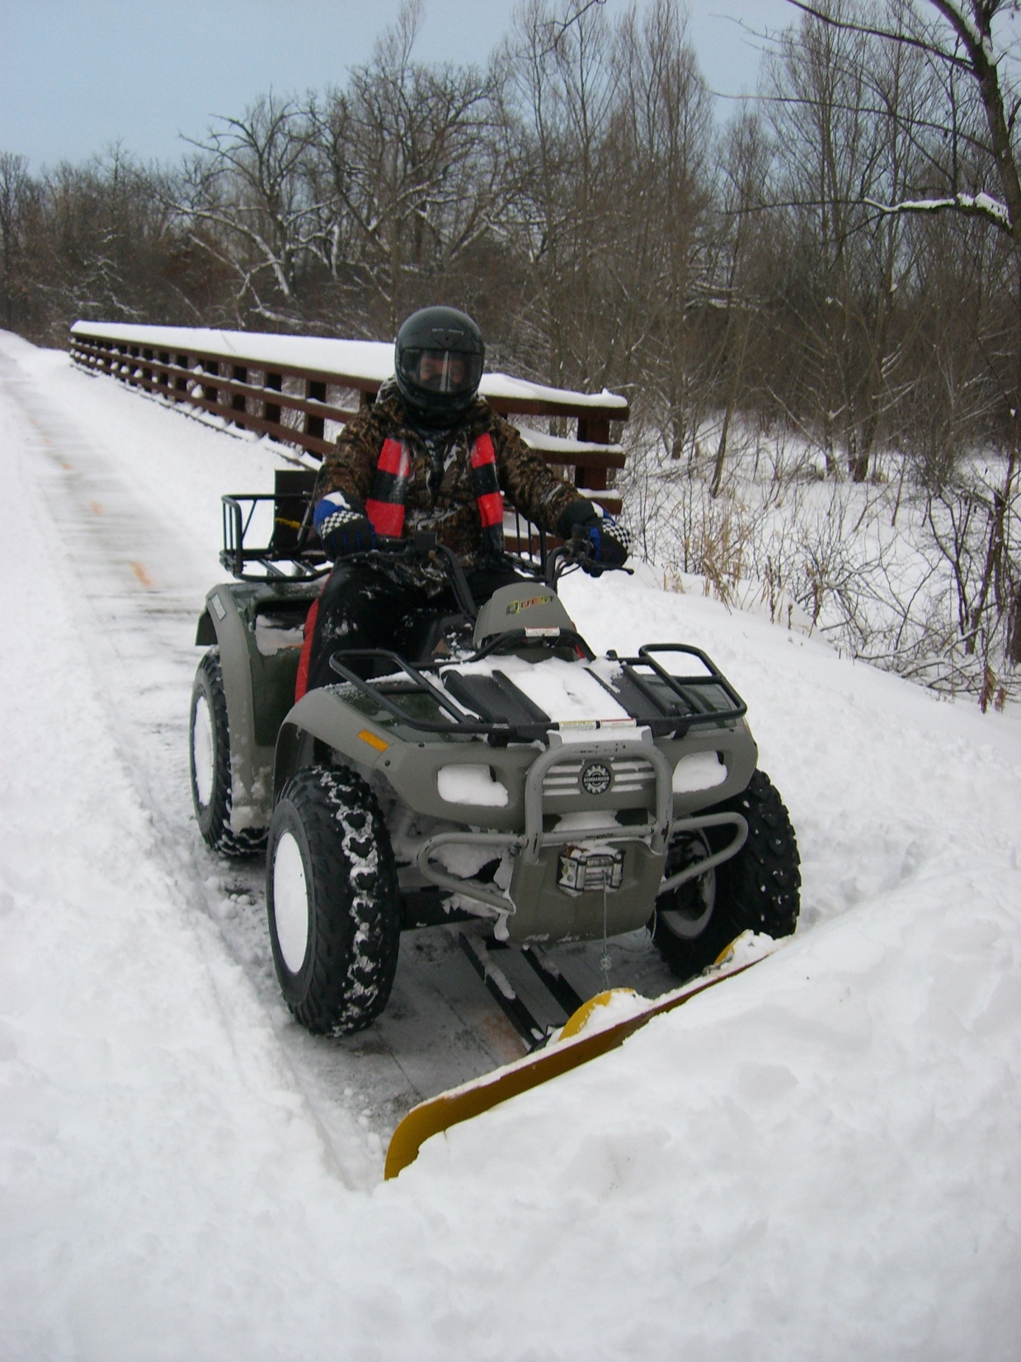
RTC plows almost 5 miles of trail from Tripp Road to Jackson Street

Slide 7
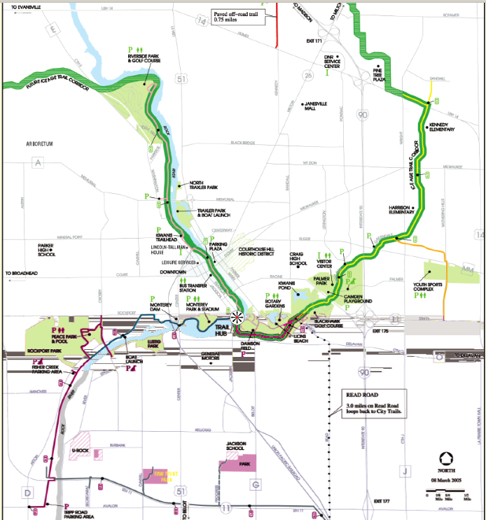
New Trail Connections
North - Hwy 26 corridor – trail to Watertown
West - Ice Age Trail – 3 miles of new trail since 2009
South - Peace Trail – Janesville to Beloit

Slide 8
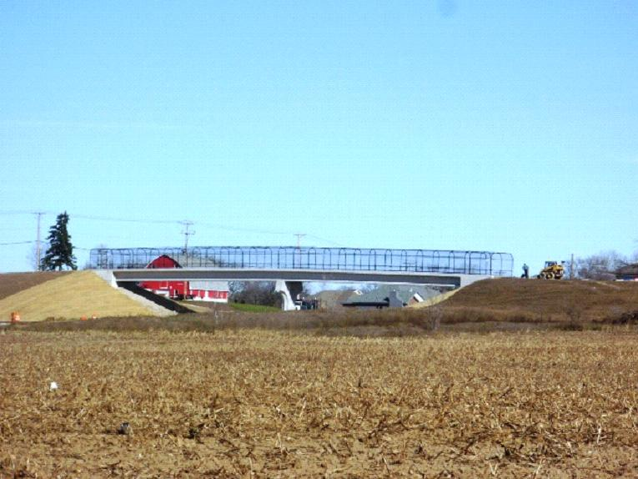
North
Hwy 26 Corridor Trail

Slide 9
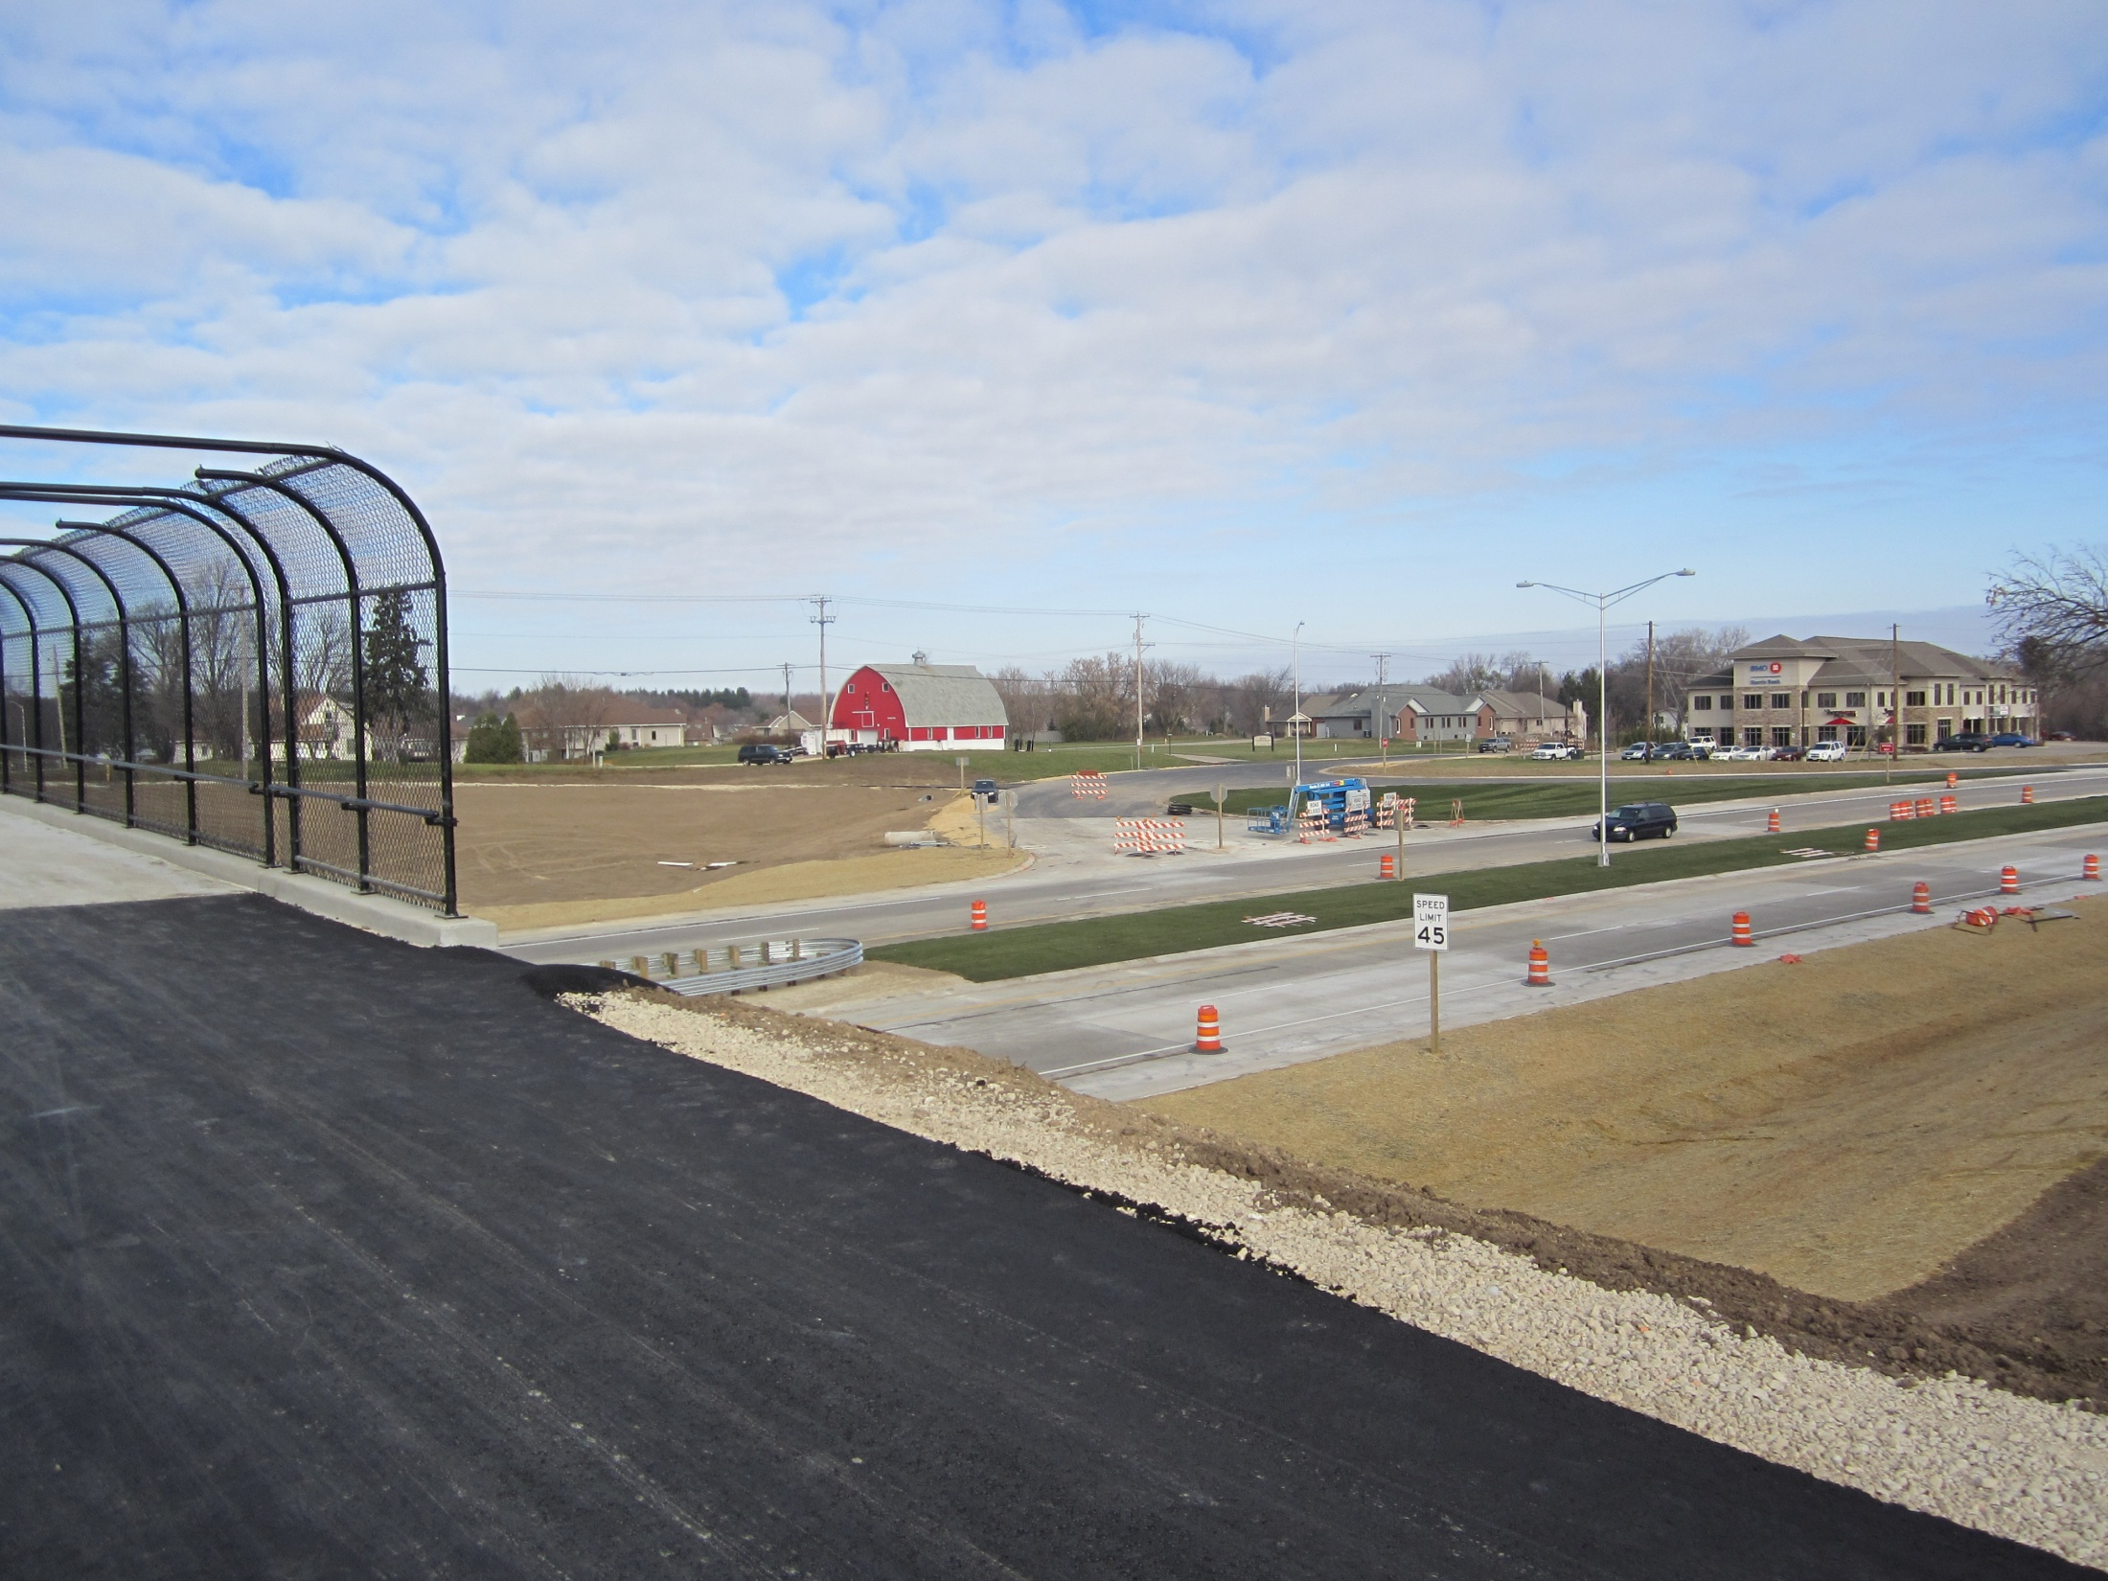

Slide 10
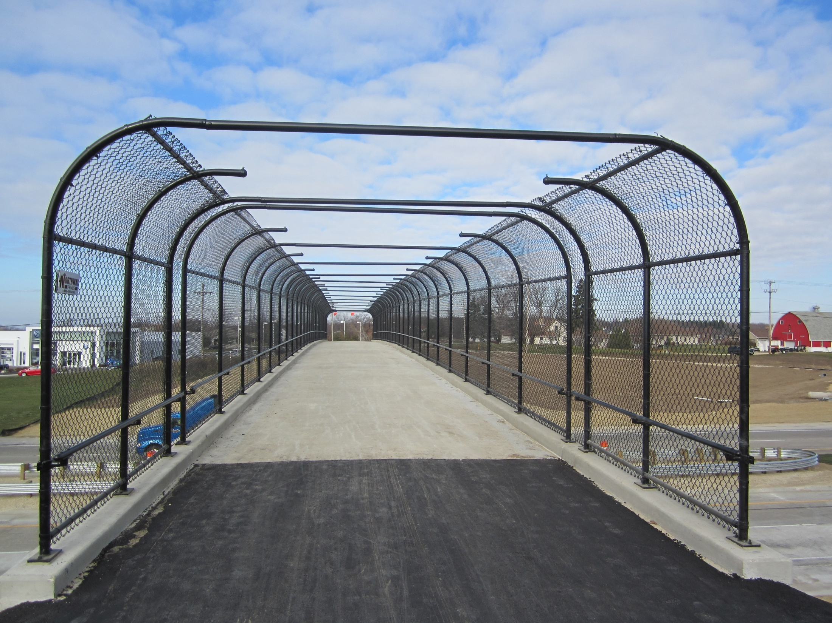

Slide 11
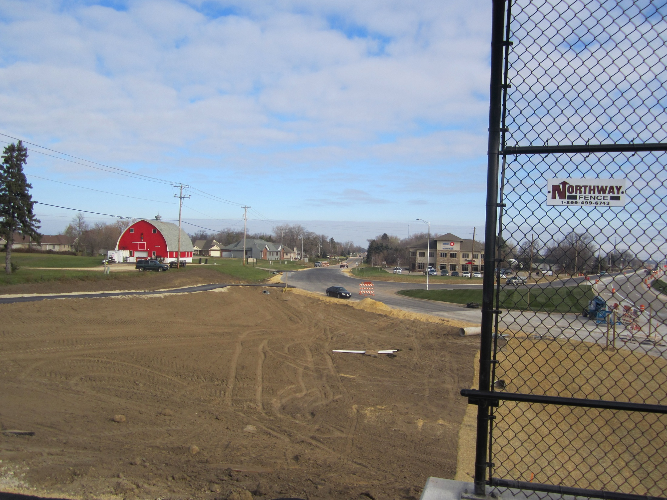

Slide 12
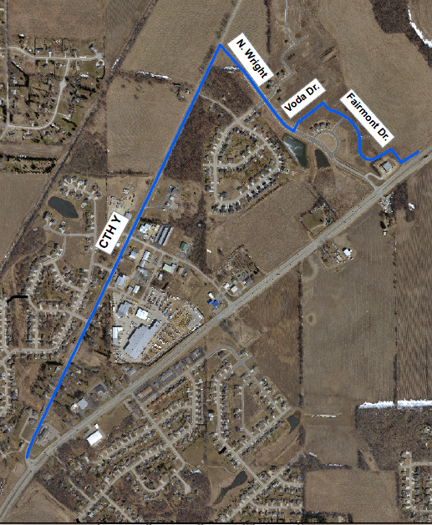
Bike/Ped Overpass

Slide 13
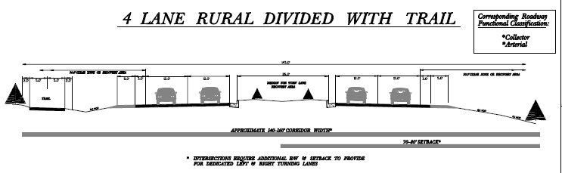
40 miles to Watertown

Slide 14
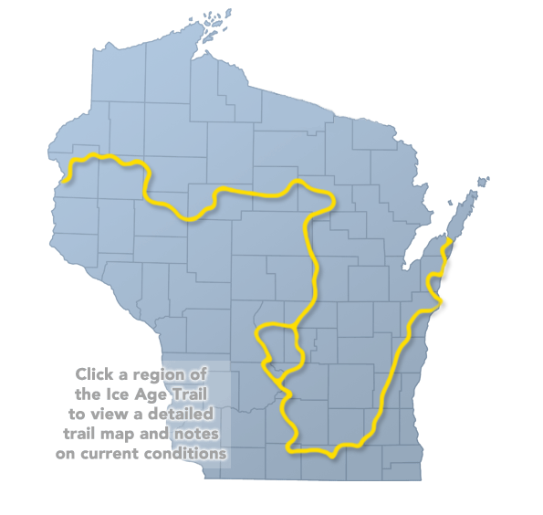
West
Ice Age Trail
1200 mile foot path
  Bike trail through town
Devils Staircase
Arbor Ridge
Cook Arboretum
Rock County Chapter - Ice Age Trail Alliance

Slide 15
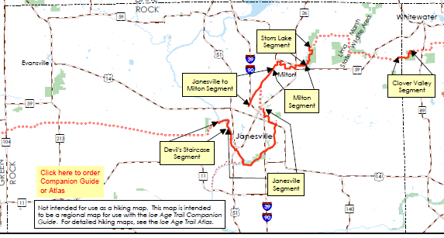
Ice Age Trail in Rock County
49.7 miles

Slide 16
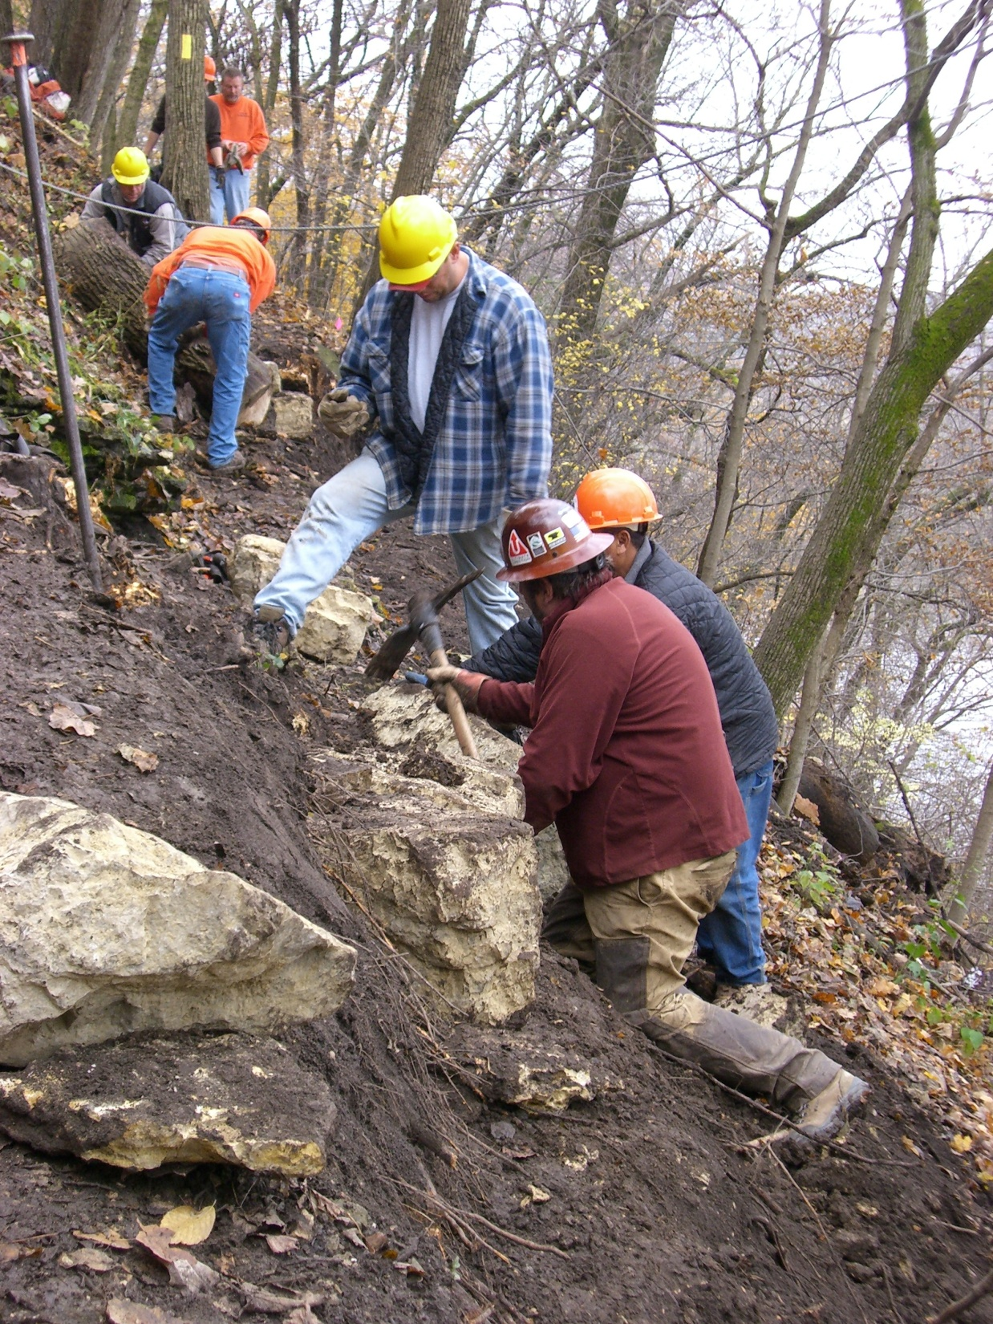

Slide 17
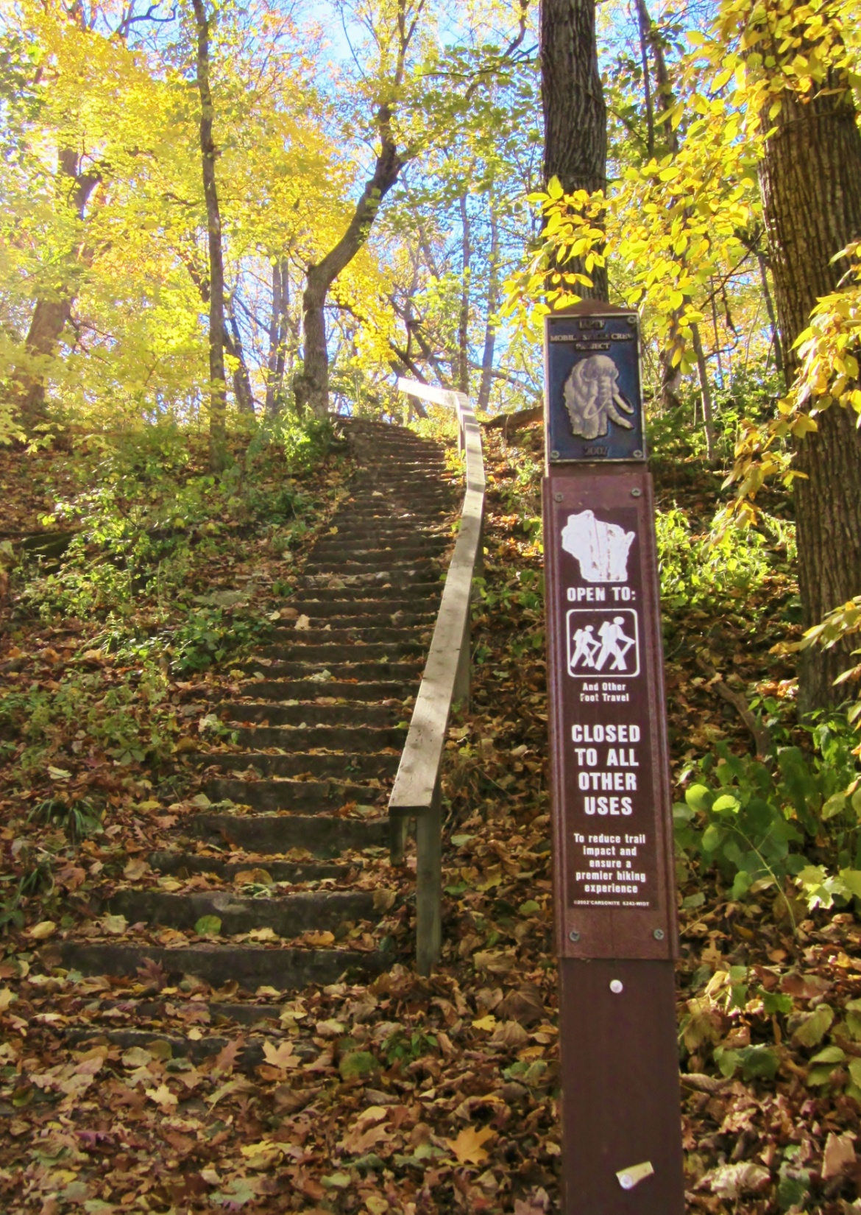

Slide 18
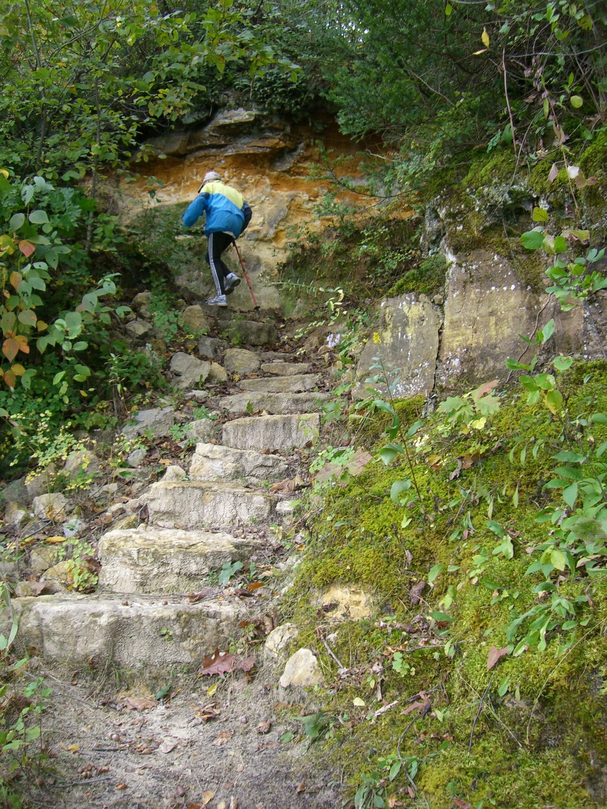

Slide 19
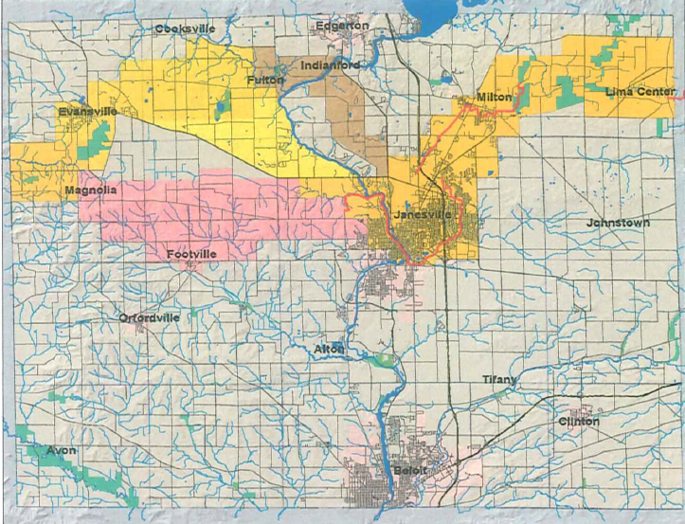
IAT/NPS/DNR Corridor Planning Process

Slide 20
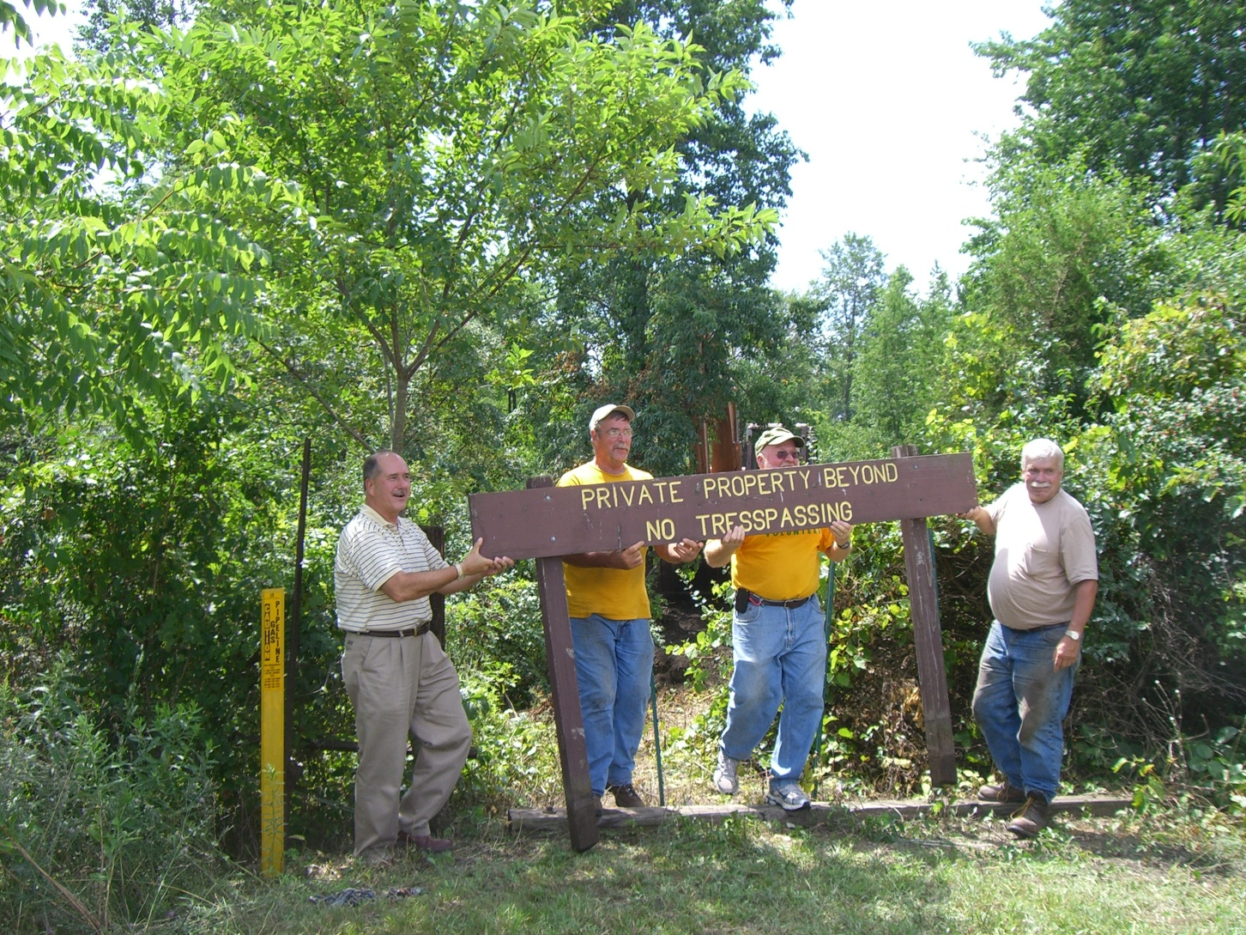
Rock Trail Coalition
South
Peace Trail Beloit-Janesville

Slide 21
Tripp Road end paved trail

Slide 22
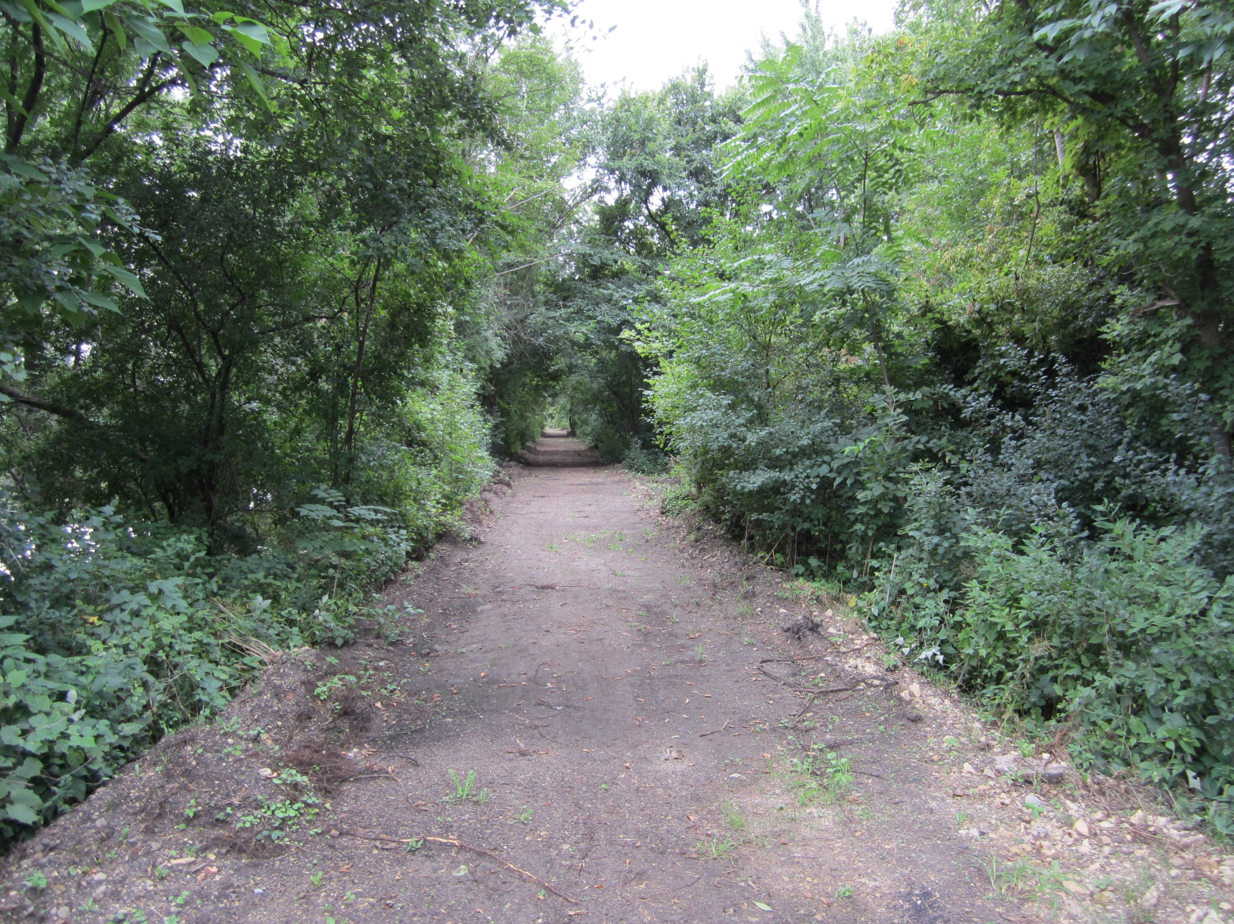

Slide 23
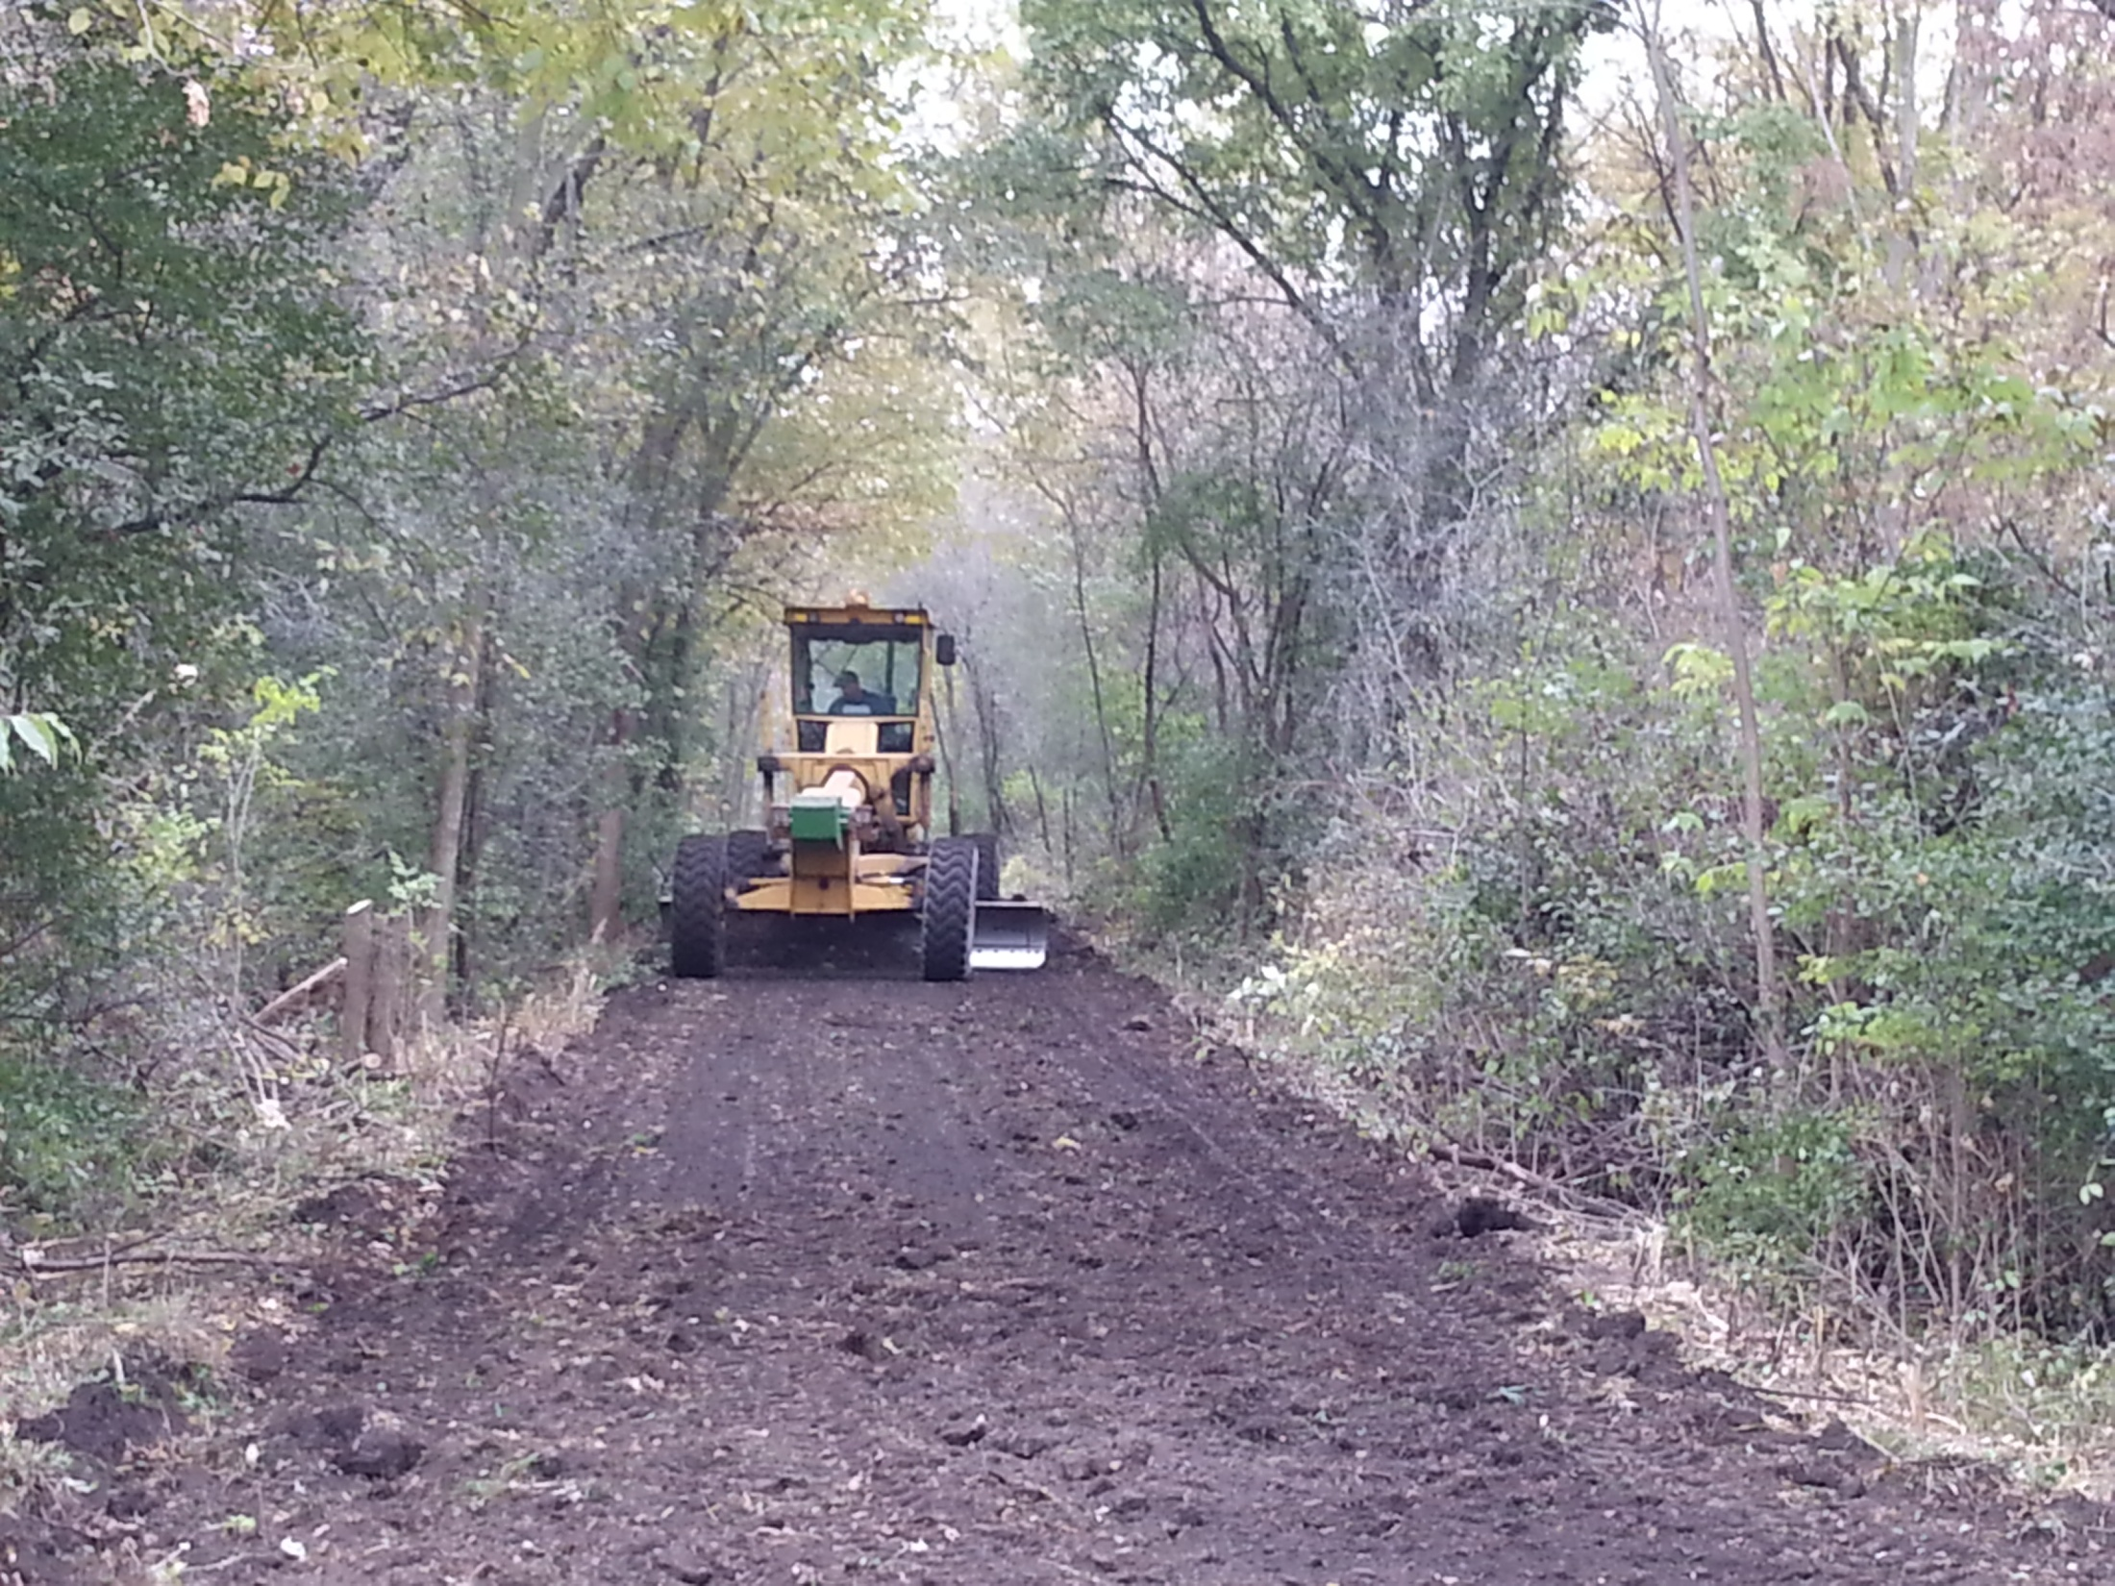

Slide 24
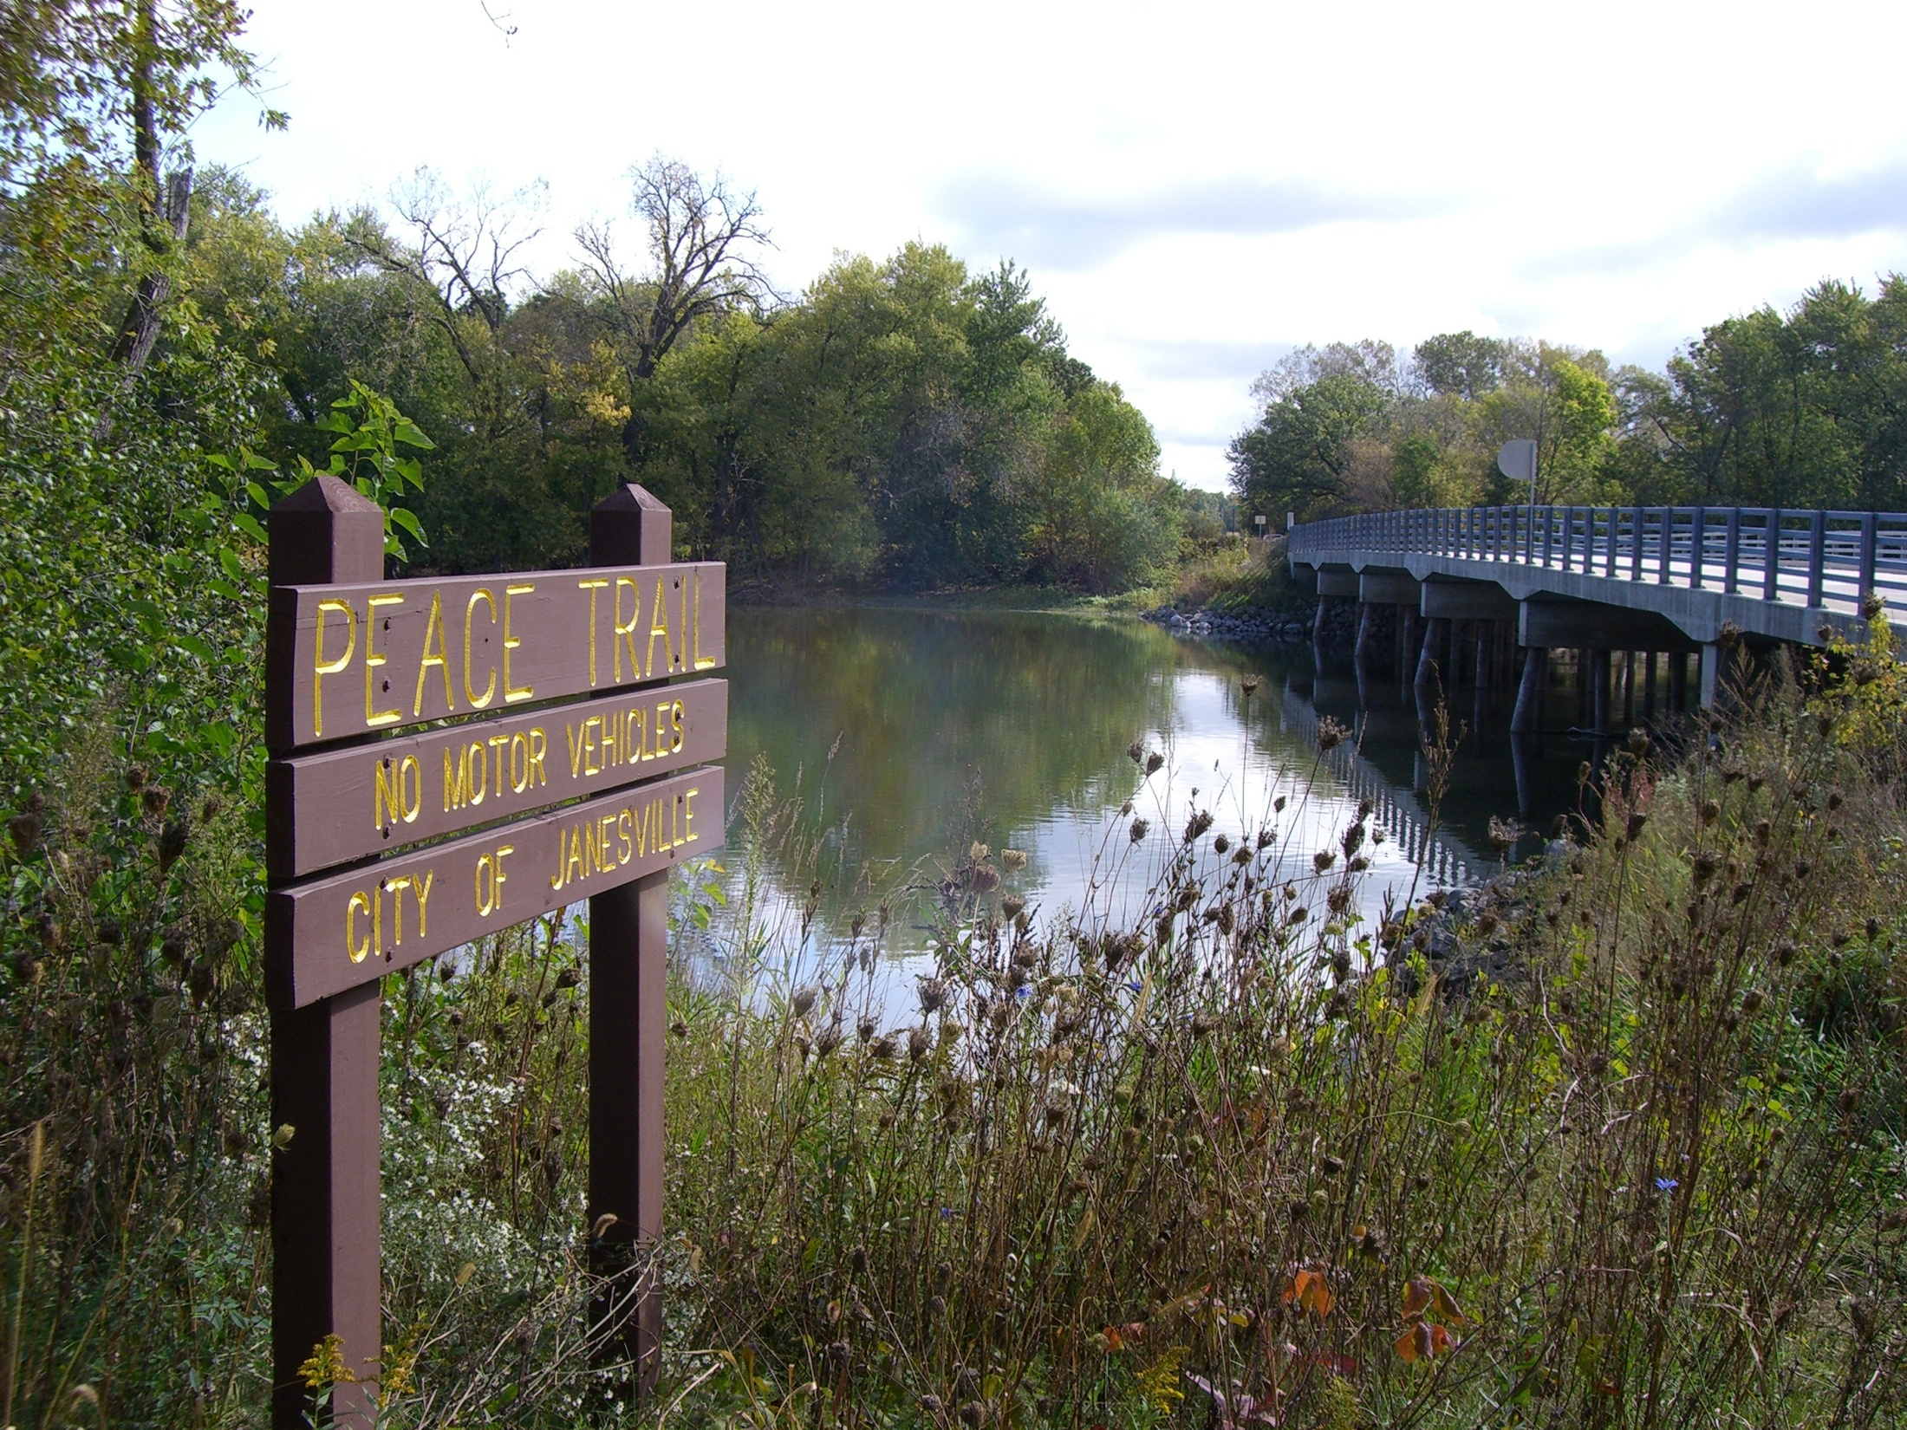

Slide 25
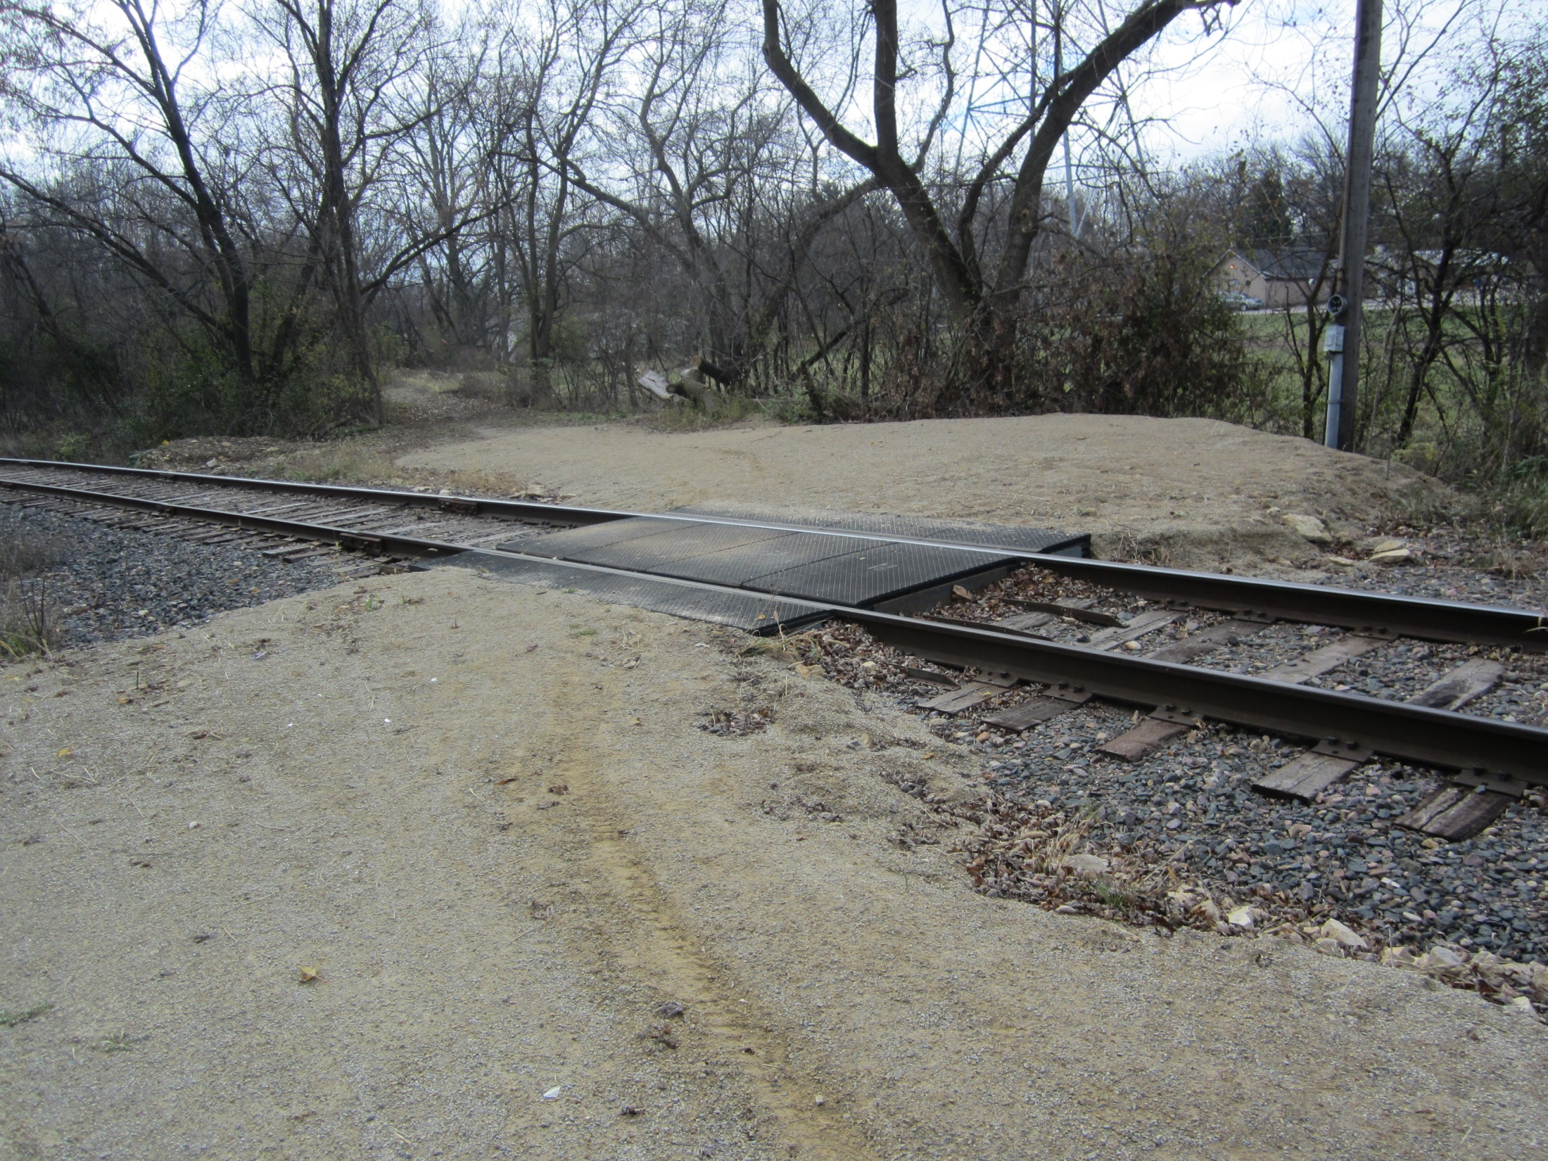

Slide 26
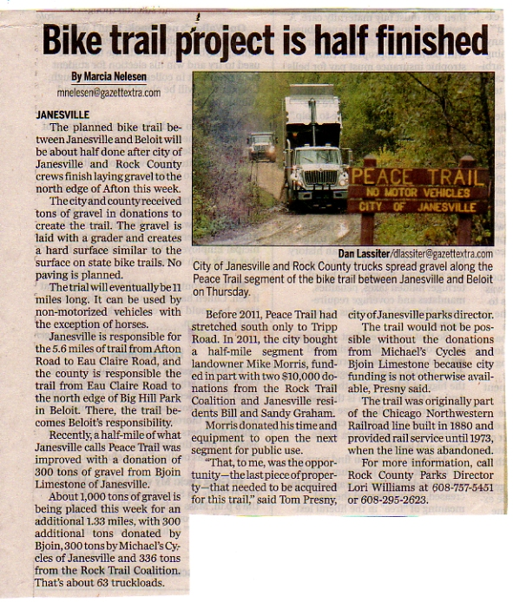

Slide 27
THANK YOU
Bjoin Limestone
Michael’s Cycles
City of Janesville
Rock County
Rock Trail Coalition members and donors

Slide 28
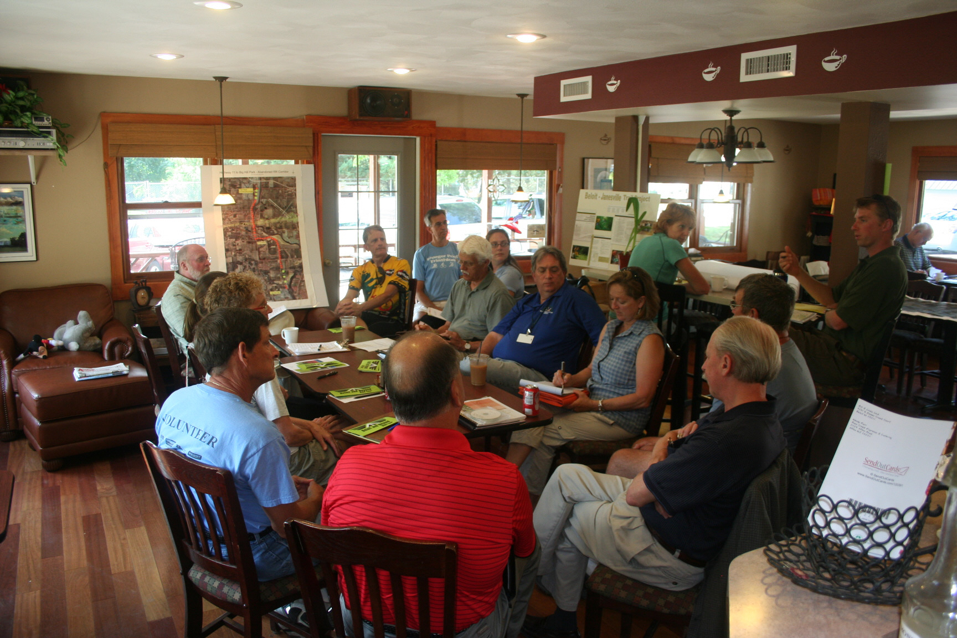
Continuing South
Afton to Beloit

Slide 29
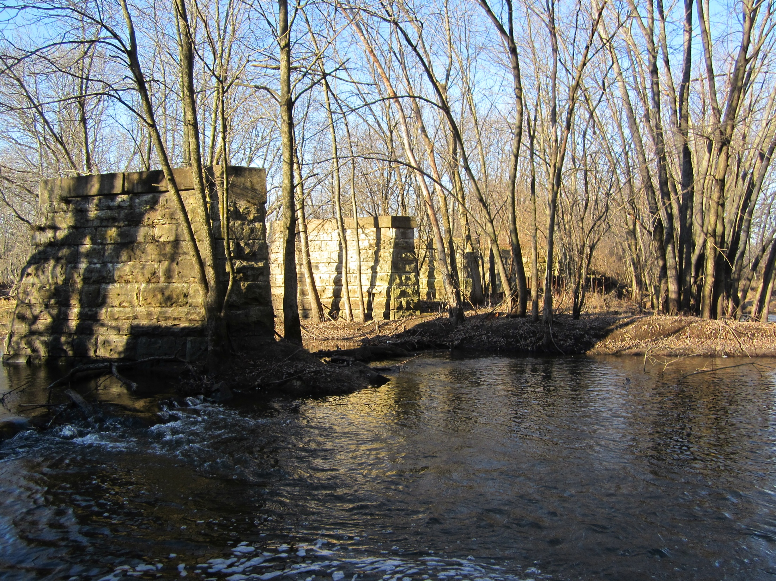

Slide 30
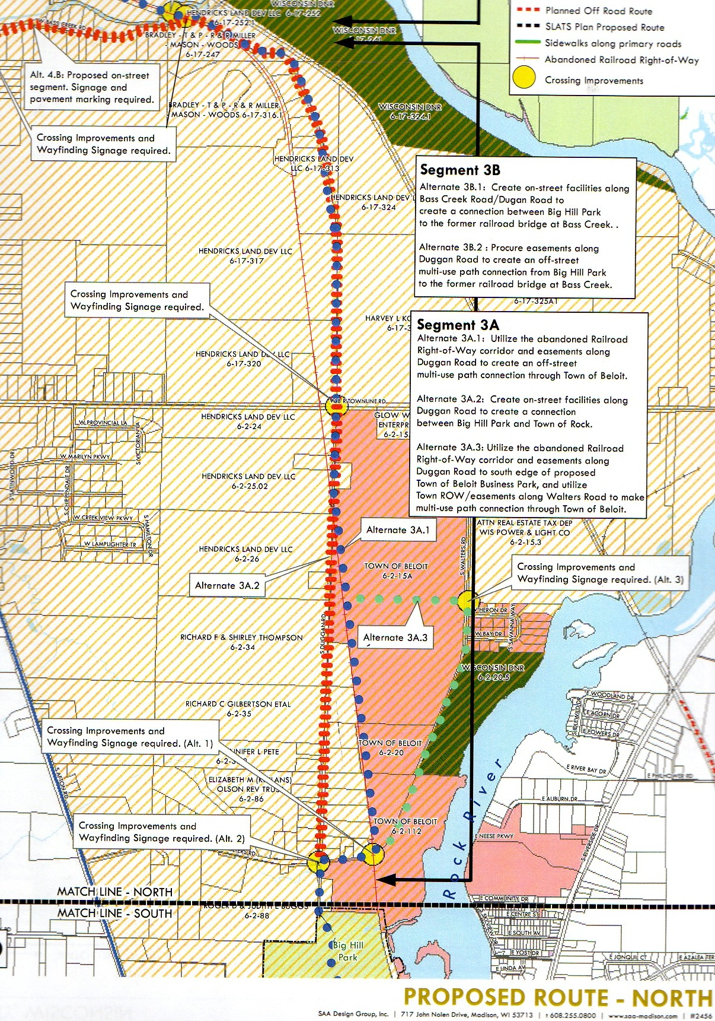

Slide 31
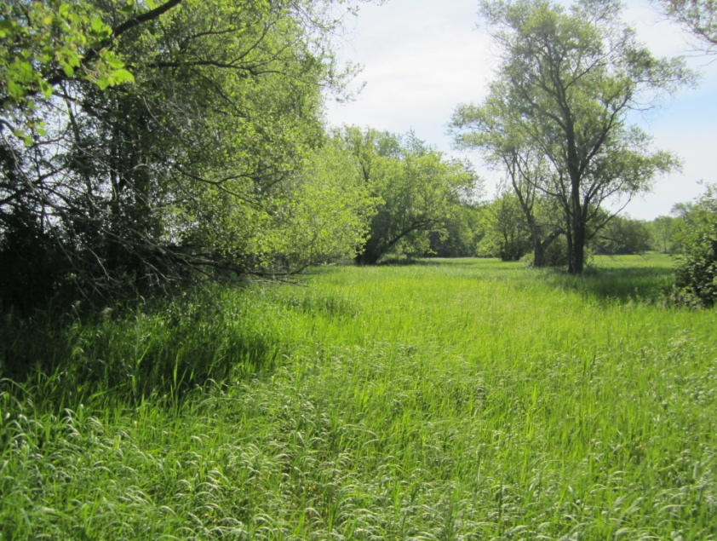
Beloit Township Savannah
Rock Trail Coalition

Slide 32
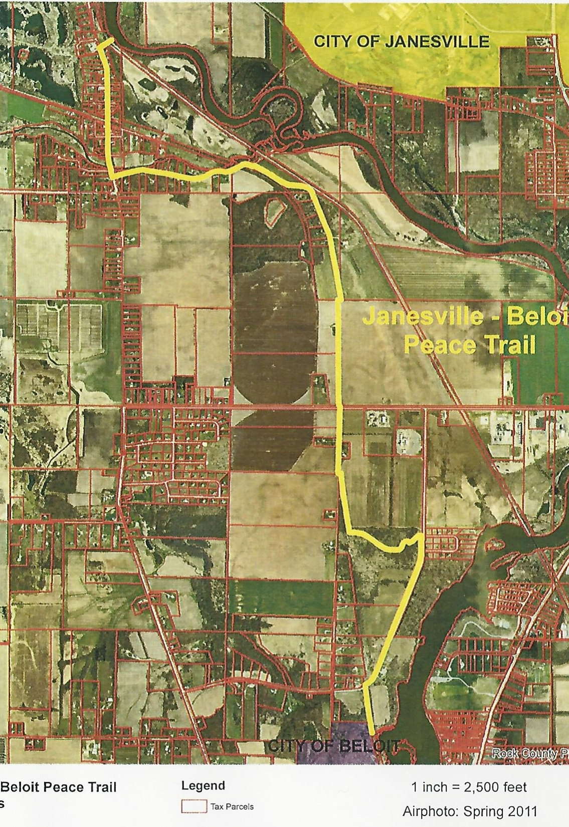

Slide 33
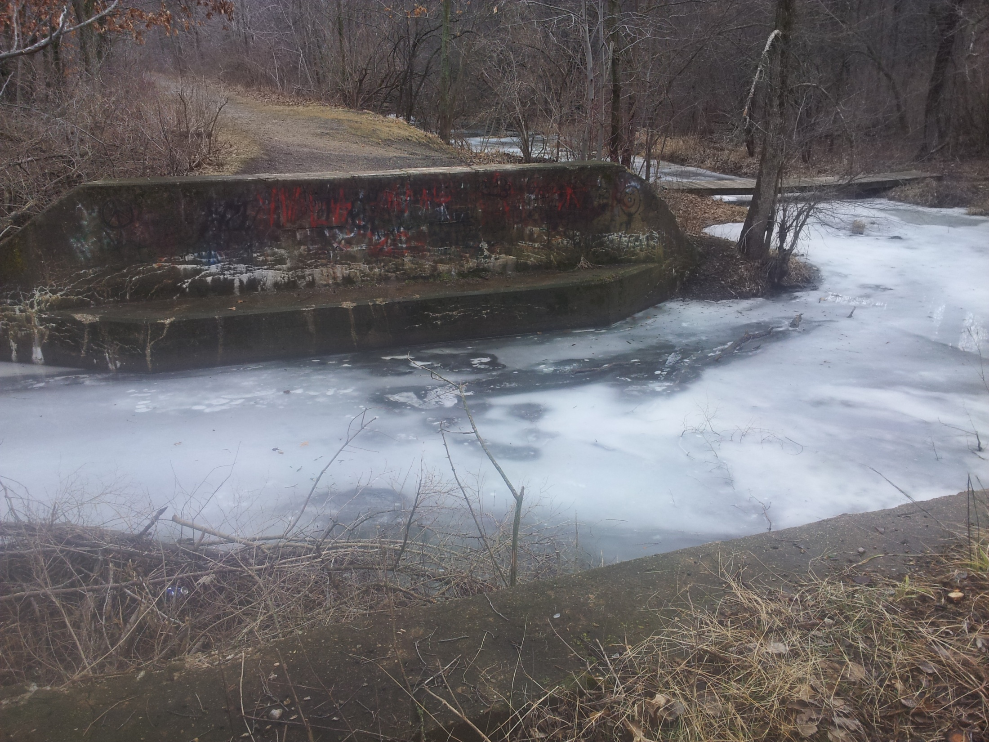

Slide 34
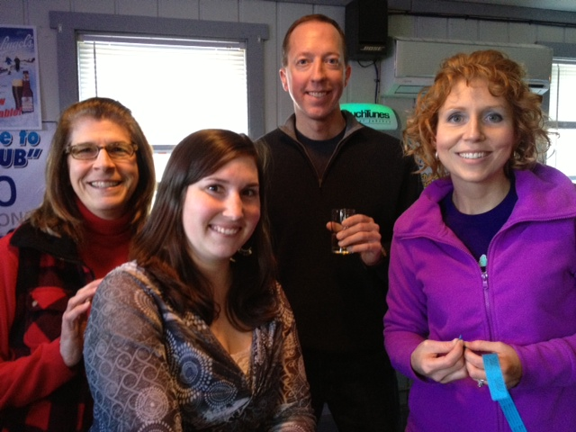
LDA Team & RTC one day fundraiser $5,536 !!

Slide 35
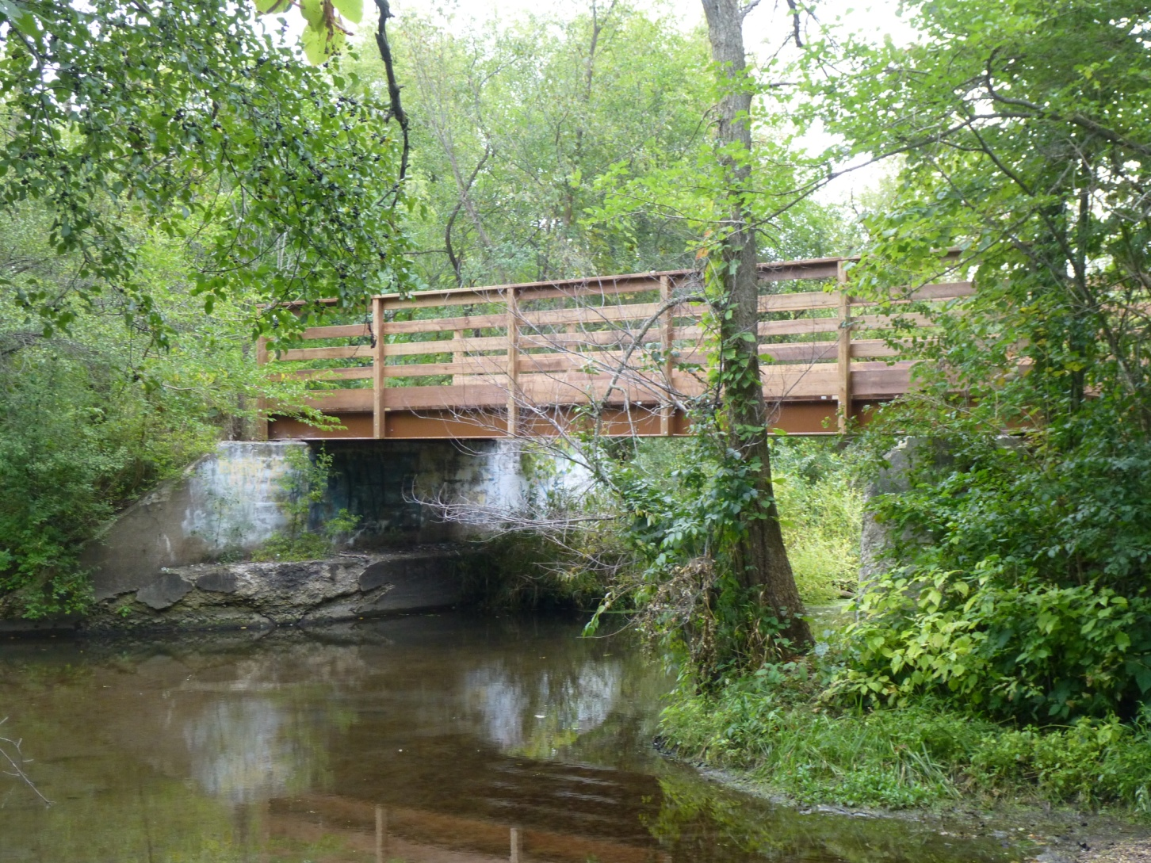
The Bridge is in!

Slide 36
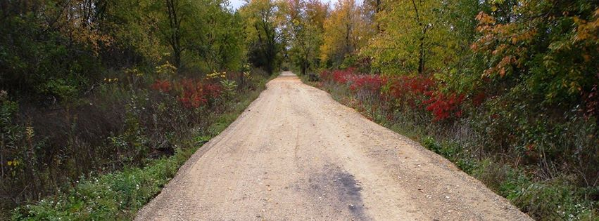
Vision for the Peace Trail

Slide 37
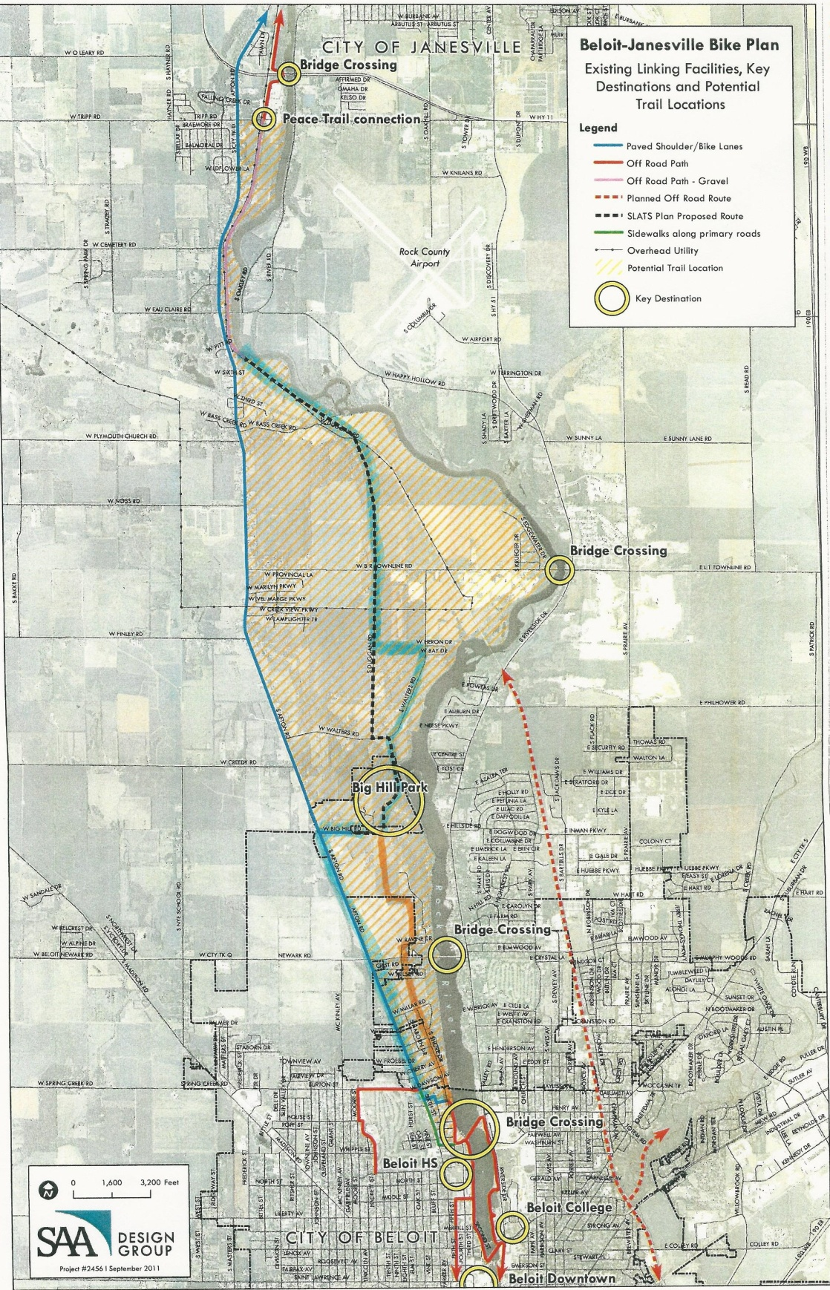

Slide 38
Odds and Ends
Trail or cycling related projects
  County G – paved shoulders
  Velo club slow rides
  Bike Friendly Community

Slide 39
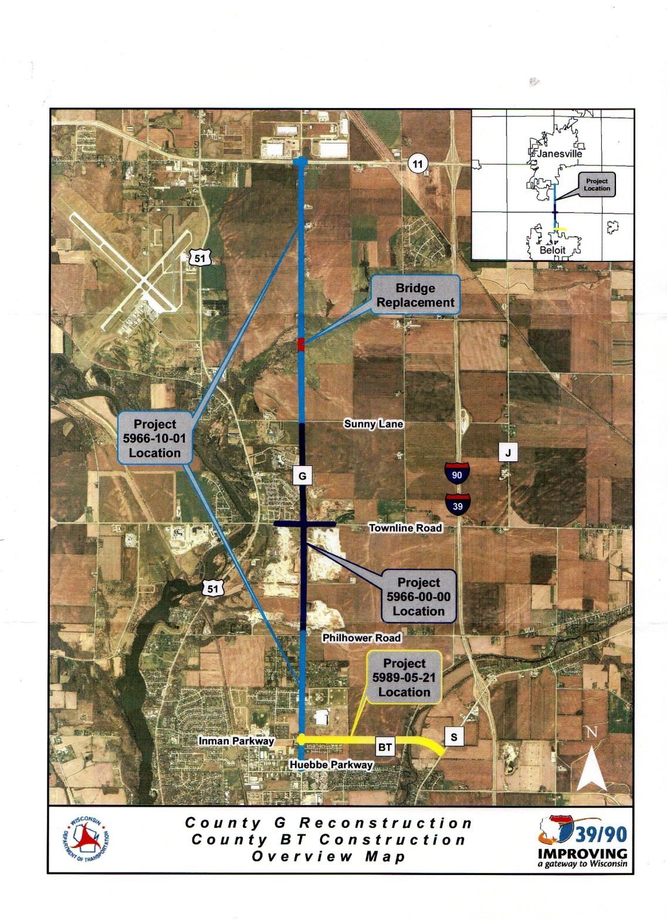
Bike lanes along County G

Slide 40

Some might ask …
“What good are all these trails???”

Slide 41
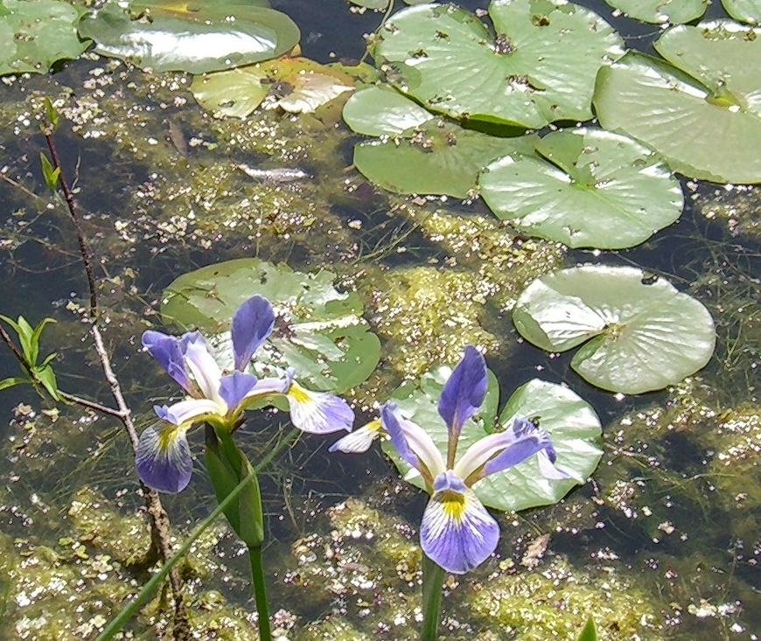
Trails are good for…
Nature lovers
Cyclists
Trail Towns
Runners
Walkers
Tourism
The Environment
Birders
Rollerbladers
Wildflowers
Health & Fitness
Dogs & Fitness
Peace of mind
Renewing your spirit

Slide 42
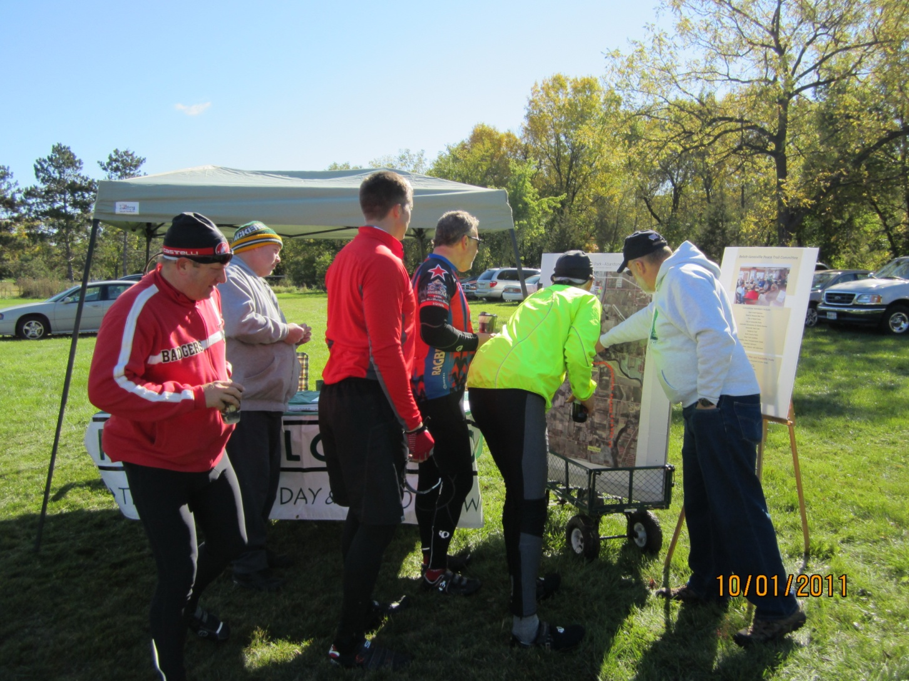
Thank You.
Questions? Comments?

