Slide 1
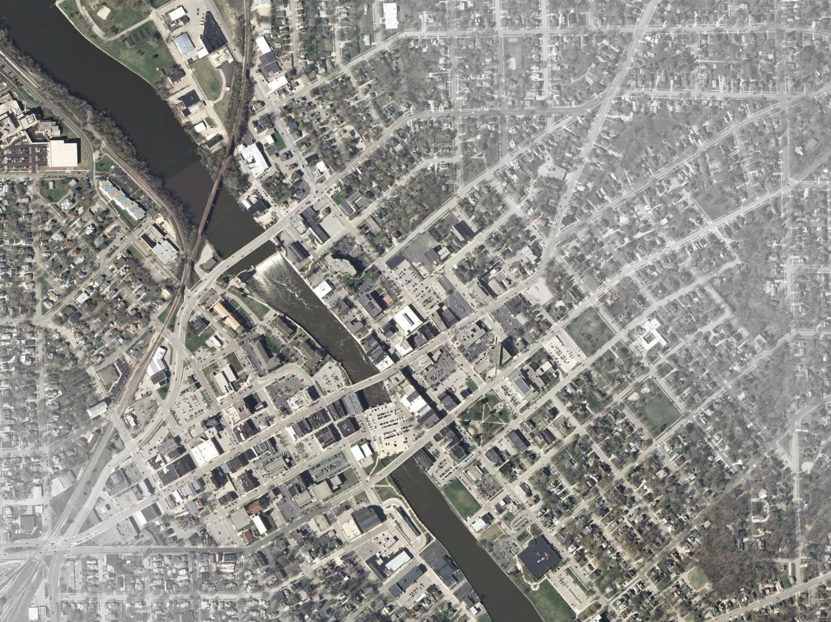
ROCK RENAISSANCE REDEVELOPMENT & IMPLEMENTATION STRATEGY
2014 MPO/RPC Fall Planning Conference:September 24, 2014
Ryan Garcia – Redevelopment Coordinator
City of Janesville, Wisconsin

Slide 2
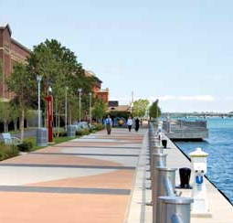
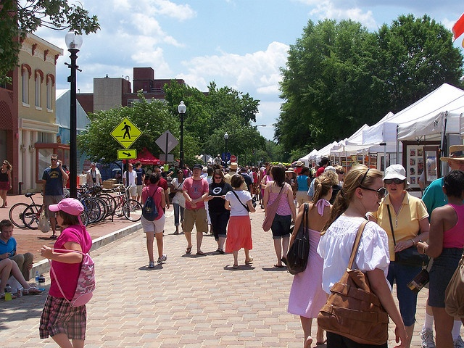
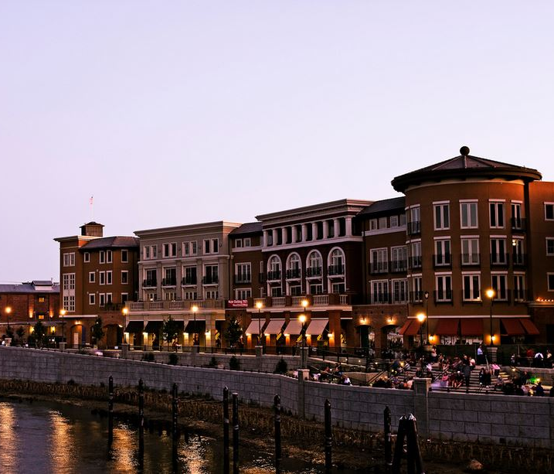
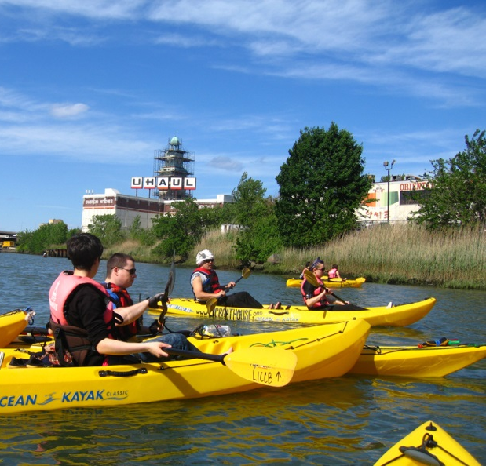
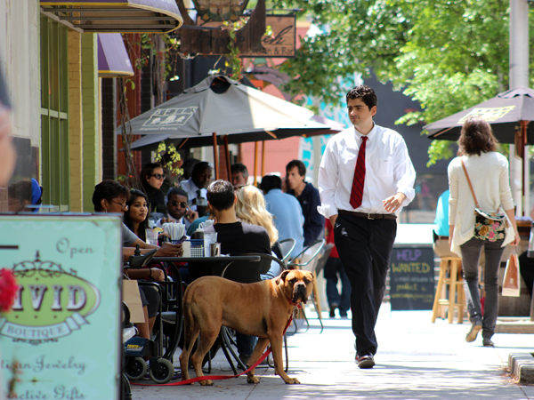
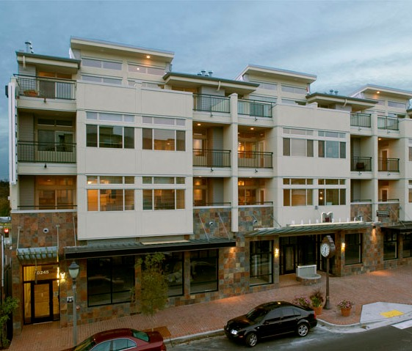
Imagine

Slide 3
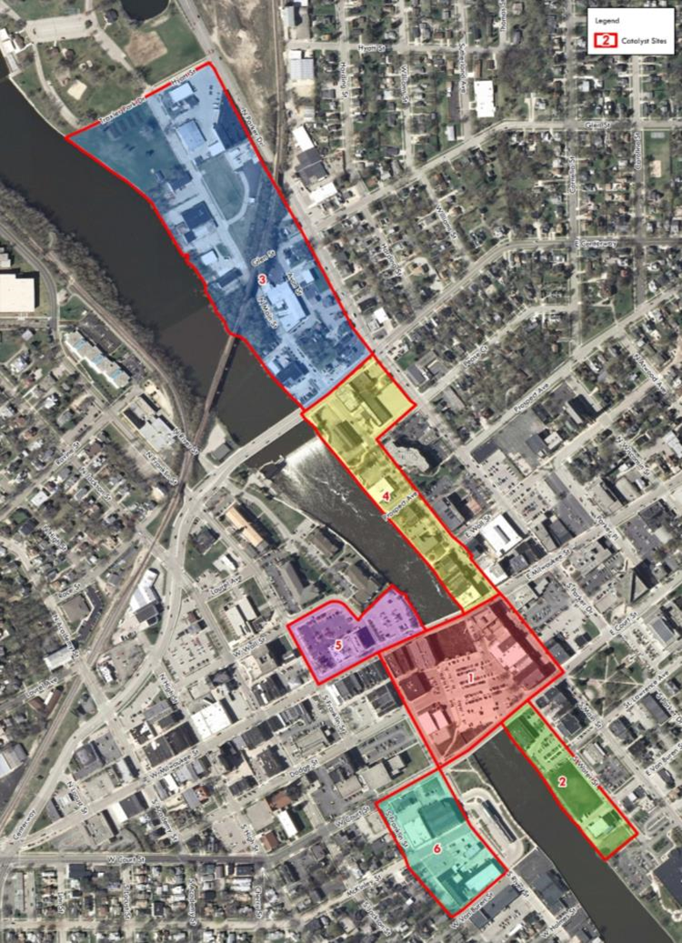
ARISE – Genesis and Purpose
Janesville’s Comprehensive Brownfields Program
  Maximize developable land
  Establish new facilities
  Promote significant job creation
WHY?
High Performing Commercial @ I-90/26
  Over $18M in value on 26 Acres – approx. $700K/acre
  Over 1000’ each of sanitary sewer, water supply, and storm sewer lines
High Performing Mixed Use on Milwaukee St.
  Almost $1.3M in value on 21,000 SF (less than ½ acre) – approx. $2.7M/acre
  About 100’ each sanitary sewer, water supply, and storm sewer lines

Slide 4
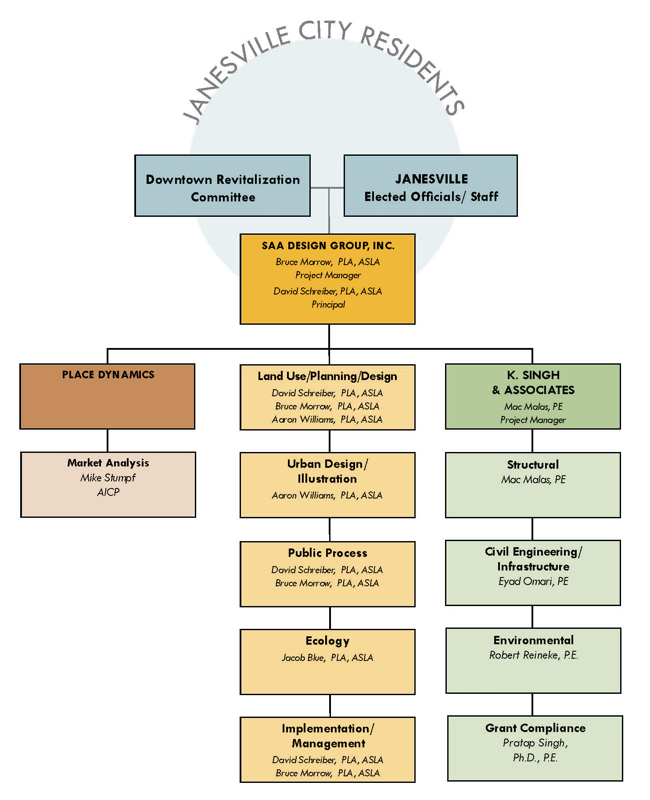
ARISE - Process
Project Team & Roles
Work Plan/Schedule
Community Engagement Efforts
  Press
  Website
  DRC
  Stakeholder 1-on-1s
  Public Workshops
Contextual Research and Data Collection
  Past Plans and Studies
  Project Area and Catalytic Sites

Slide 5
Project Goals
Make the downtown the heart of the community and a fun, vibrant and healthy place to live, work and visit for a wide spectrum of the community
Preserve the historical character and authenticity of the downtown
Celebrate the Rock River as Janesville’s greatest asset
Facilitate new investment and redevelopment with a market driven and action oriented strategy

Slide 6
Desired Outcomes
The downtown and riverfront are the first places you go with friends and with visitors
The community embraces the river
Local and outside investment is being made in new businesses and housing
The downtown and riverfront feel comfortable and safe

Slide 7
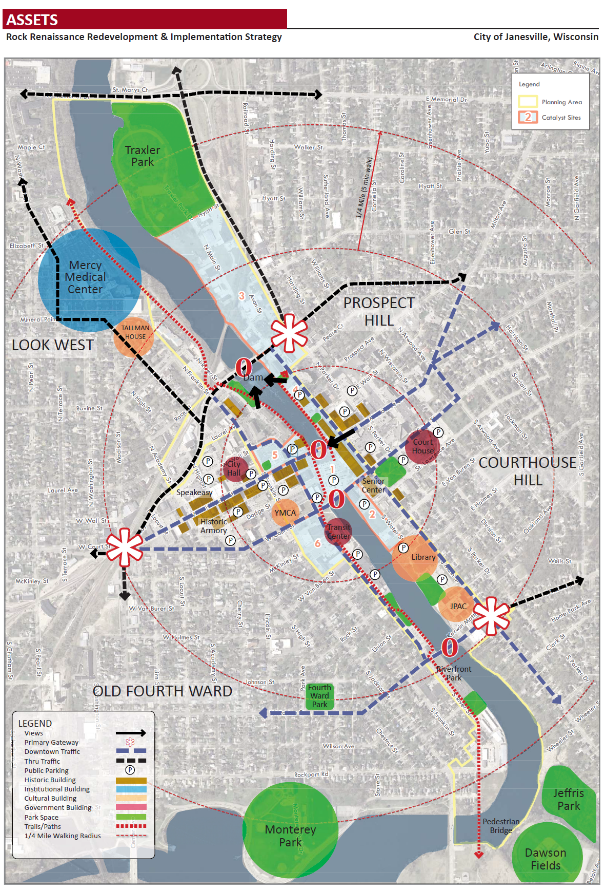
ARISE – Infrastructure Assets & Opportunities
Historic Buildings
Neighborhood proximity
Bridges over river
Abundant Parking
Existing park system and trail networks
Major employers

Slide 8
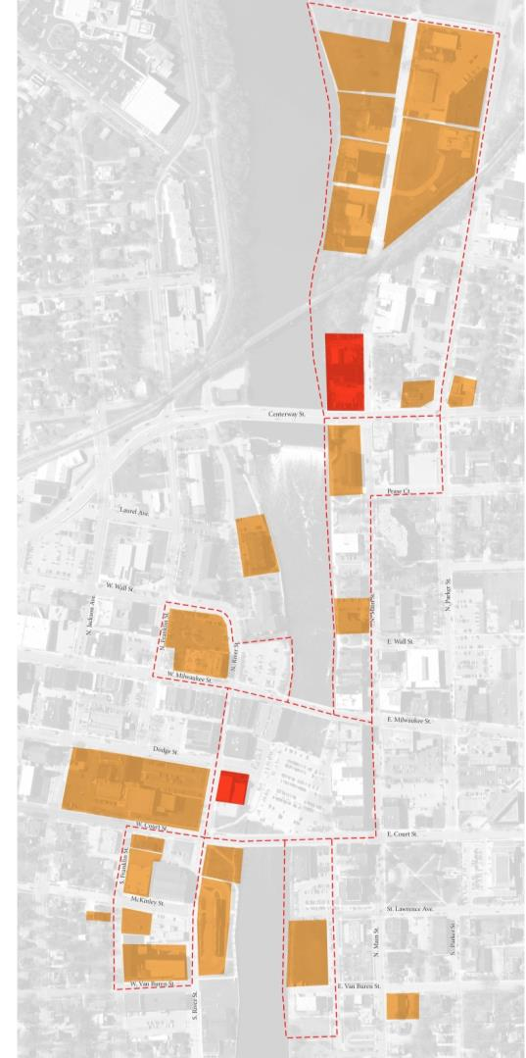
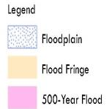
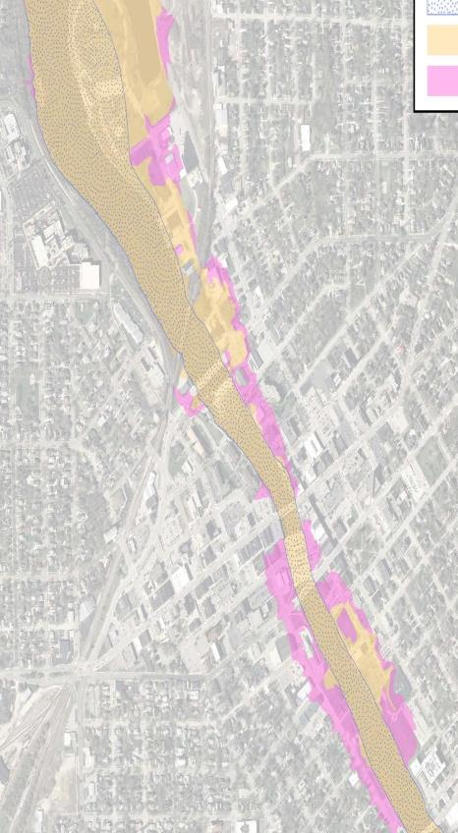
ARISE - Shaping Factors (Environmental)
Closed site
Phase II site
Floodplain
Brownfields

Slide 9
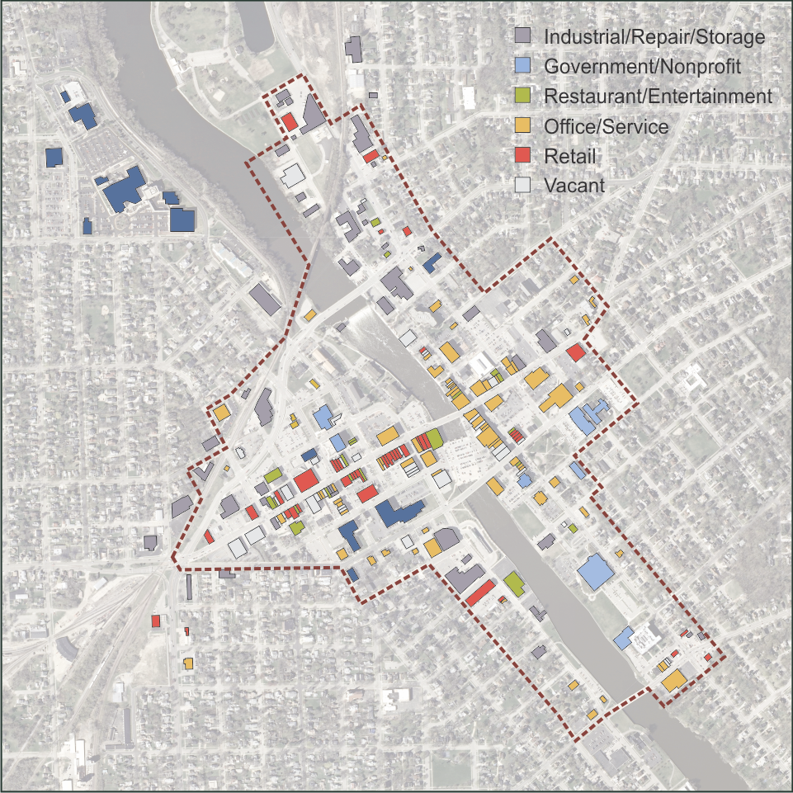
ARISE – Shaping Factors (Market)
Ground floor:
  359,600 industrial
  322,500 office/service
  192,900 vacant
  152,200 retail
  51,600 restaurant
  39,400 entertainment
Upper levels:
  106,900 vacant
  104,600 office
  55,800 residential
  43,400 industrial
  4,000 entertainment

Slide 10
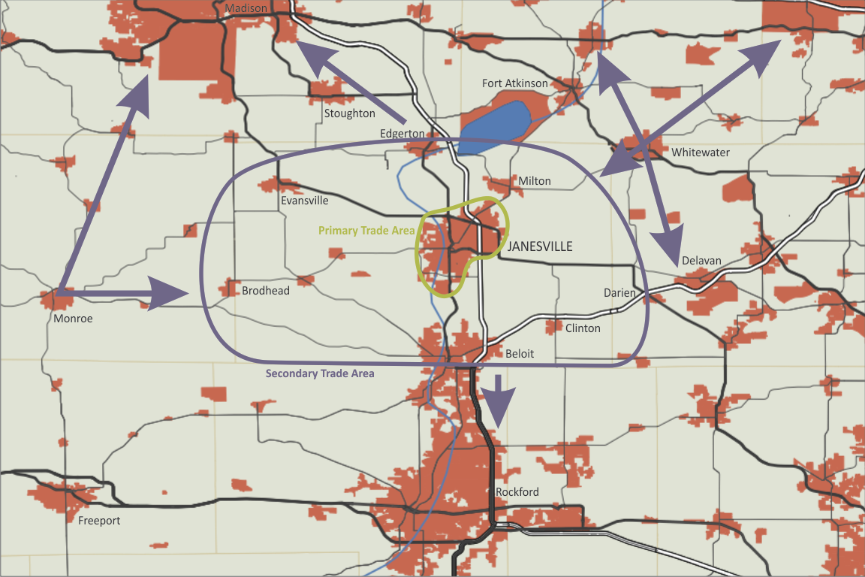
ARISE – Shaping Factors (Market)
Strong housing market
Conditional office market
Retail and dining will need help
All depend on the experience downtown can offer
  Emerging market preferences
  Urban character
  Interactive public spaces
  Unique experience

Slide 11
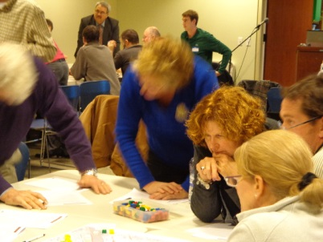
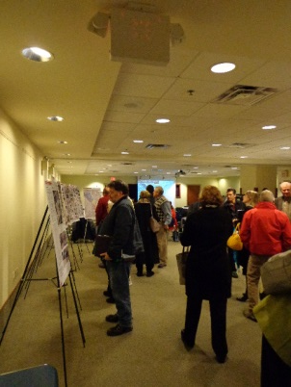
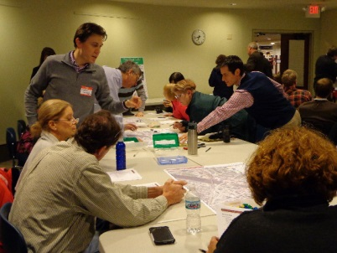
Summary of Stakeholder Feedback
1-on-1s
  Lack of vision
  Floodplain limits development
  Need for additional public space
  Central location
  Historic architecture
  Downtown community pulled in many directions
  Perceived parking issue
  Lacks connectivity
  The Janesville business community does not value the downtown
  Public projects are not of the highest quality
Community Engagement Forums
  Lack of vision, continuity, connectivity, activity, walkability
  Support for:
    Continuous river walk
    Additional housing and retail (together and stand-alone)
    Two-way streets with diagonal parking
    Kayak course
    Band shell

Slide 12
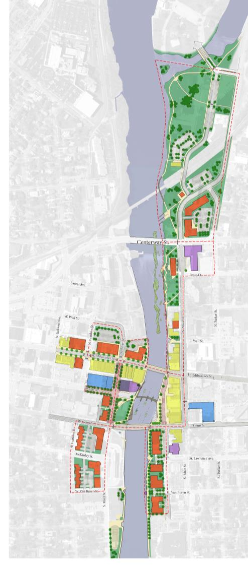
Preferred Redevelopment Strategy
A EXPAND Traxler Park to Centerway
B ACTIVATE the Rock River
C ENHANCE and UNIFY West Milwaukee Street Retail District
D CREATE Main Street Entertainment District
E DEVELOP and BRAND Town Square
F EXPAND/COMPLETE Riverfront Path and Trail Network
C
F
B
E
D
A

Slide 13
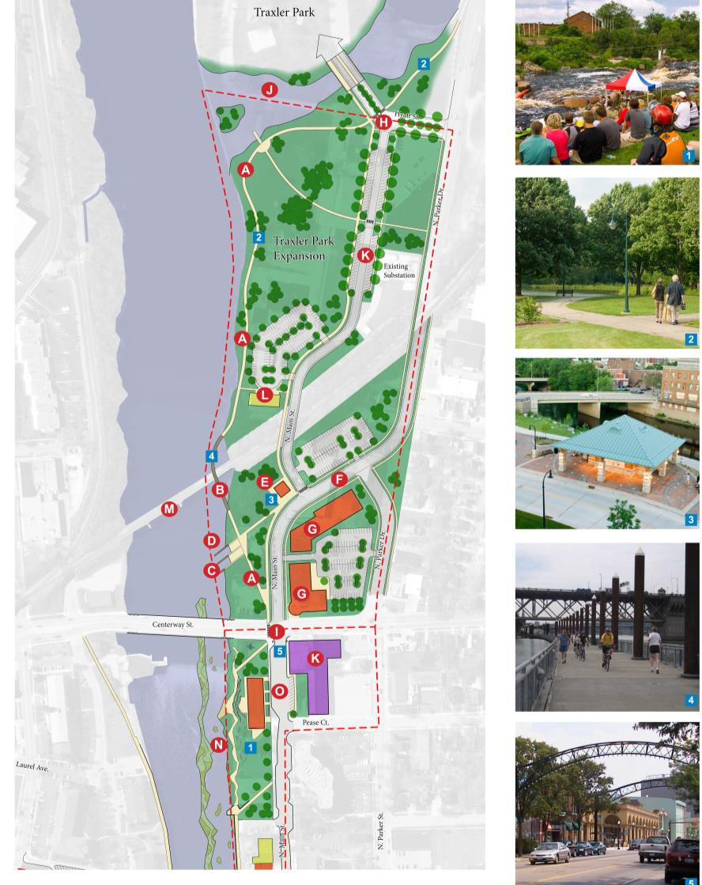
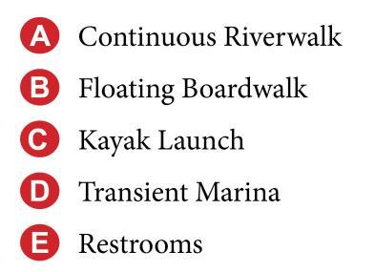
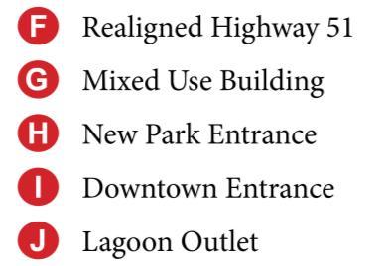
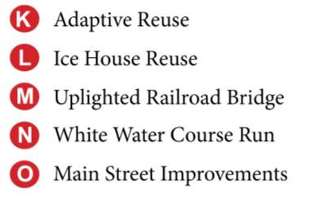
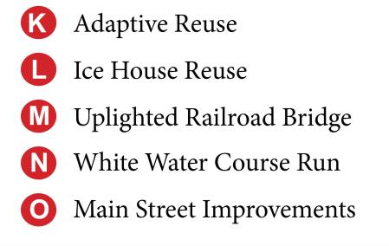

Concept: North End

Slide 14
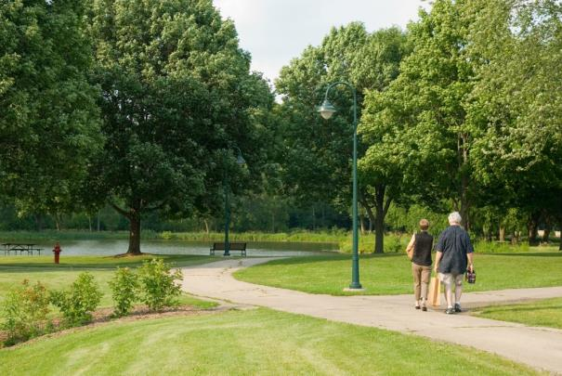
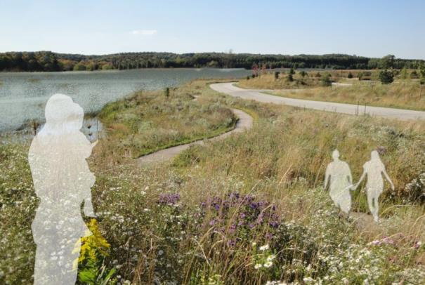
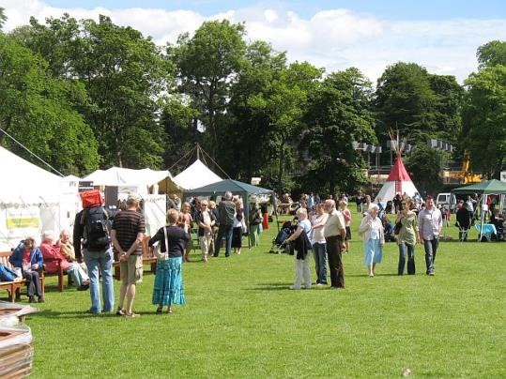
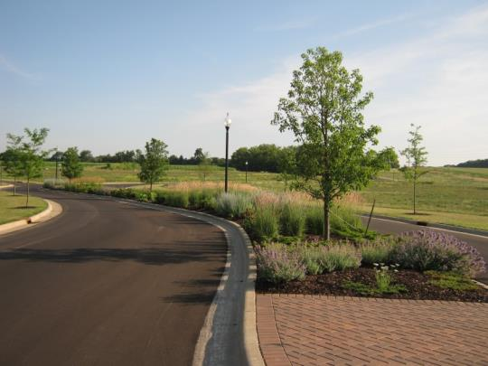
North Section - Character

Slide 15
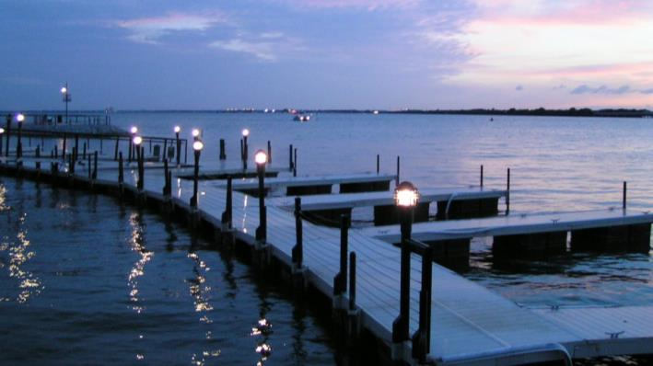
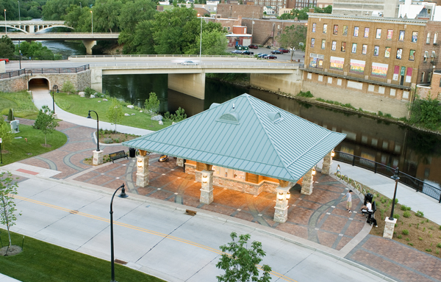
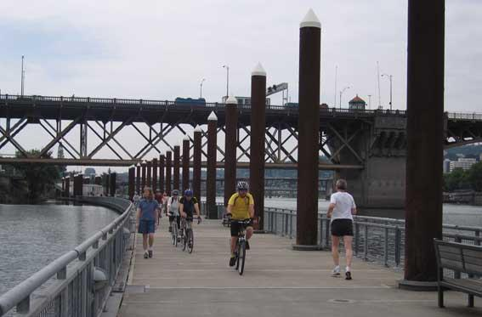
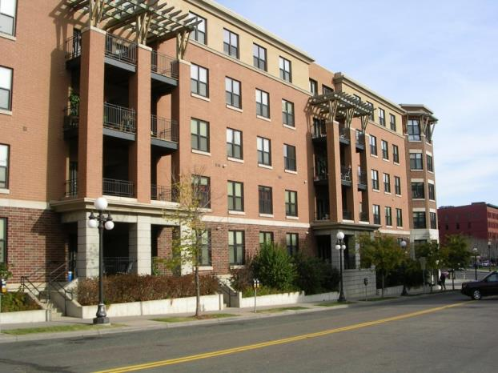
North Section - Character

Slide 16
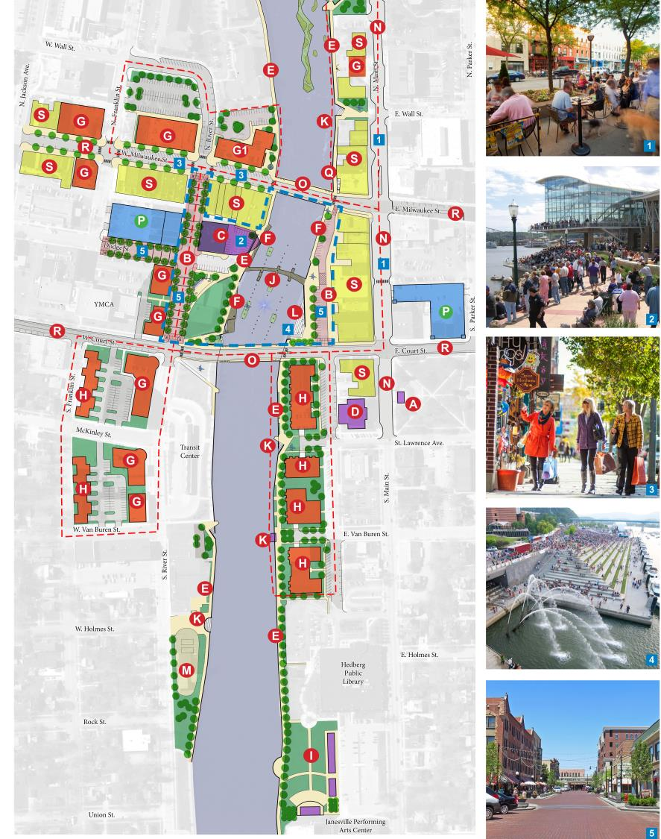
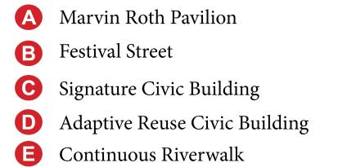
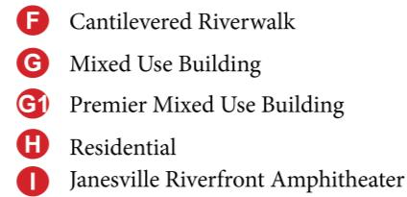
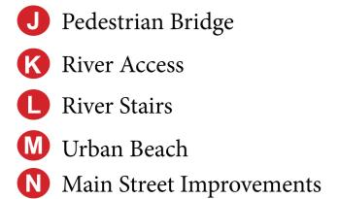
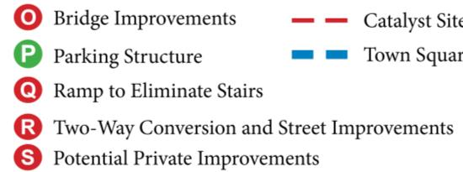
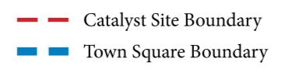
Concept: South End

Slide 17
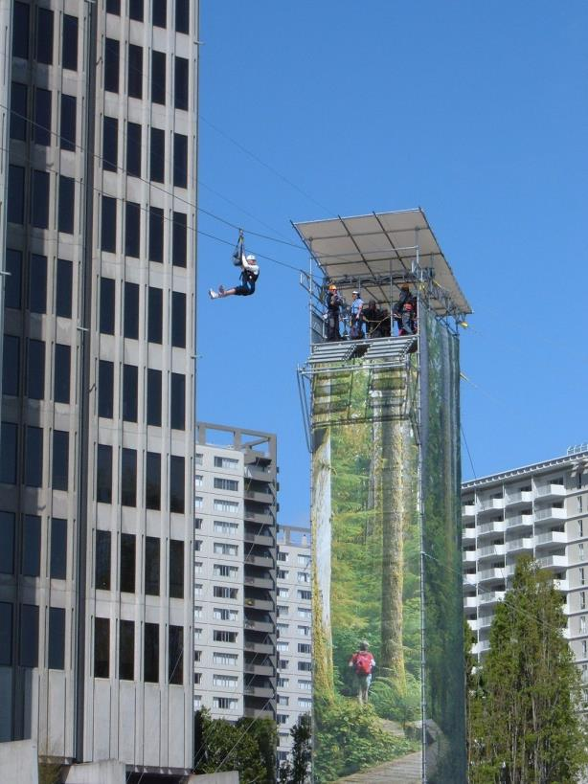
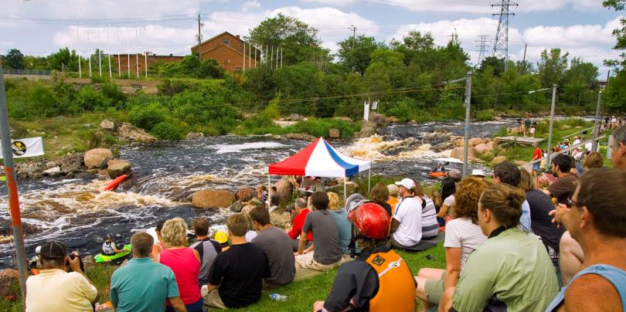
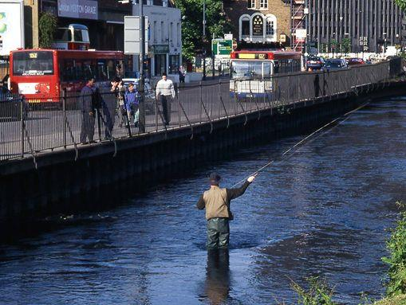
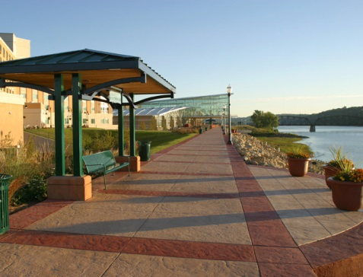
South Section - Character

Slide 18
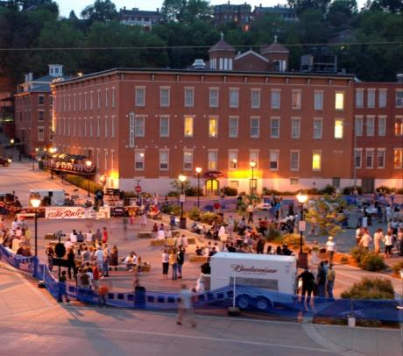
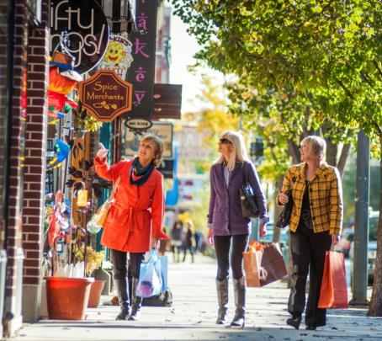
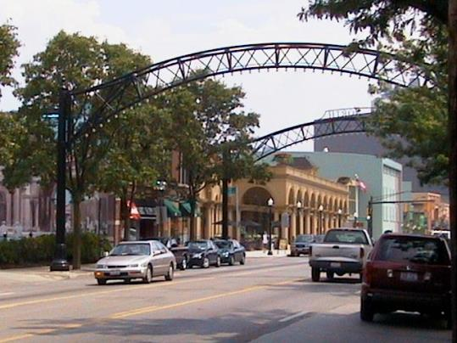
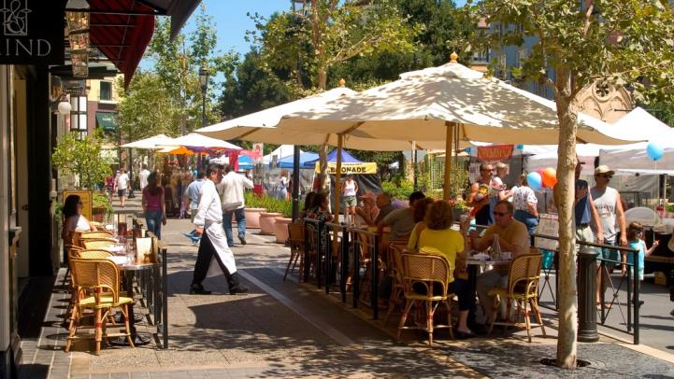
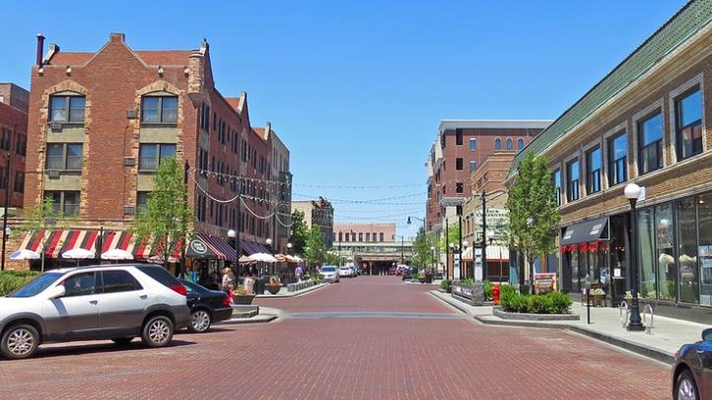
South Section - Character

Slide 19
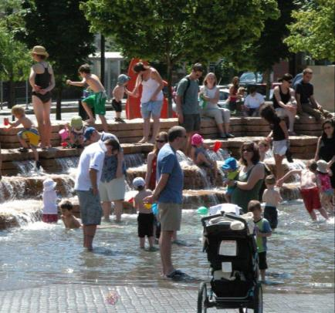
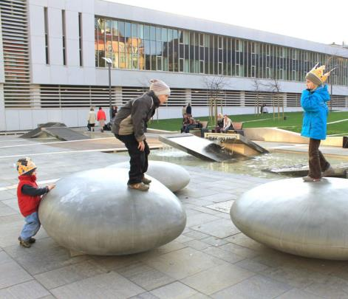
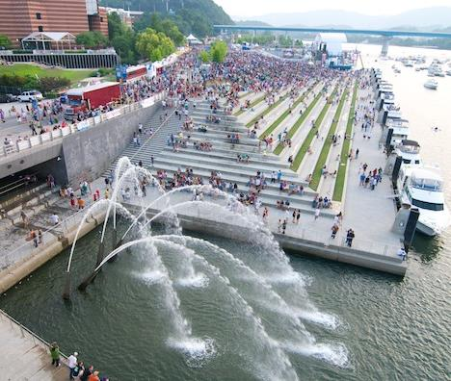



South Section - Character

Slide 20




South Section - Character

Slide 21




South Section - Character

Slide 22

CATALYST SITE 1

Slide 23

CATALYST SITE 1

Slide 24

CATALYST SITE 2

Slide 25

CATALYST SITE 2

Slide 26

CATALYST SITE 3

Slide 27


CATALYST SITE 3

Slide 28

CATALYST SITE 4

Slide 29

CATALYST SITE 4

Slide 30

CATALYST SITE 5

Slide 31


CATALYST SITE 5

Slide 32

CATALYST SITE 6

Slide 33

CATALYST SITE 6
Notes:
Ds – remove table in upper left, expand drawing
- add line for near term action? … which is no action

Slide 34
Draft Implementation Approach
Making a Place
Supporting Market Interest
Infrastructure Needs
Role of Partnerships
Action Plan
Funding Strategy
Commitment

Slide 35
Funding Sources
Tax Incremental Financing
Grants
  EPA
  DNR
  DOT
Private $’s
Business Improvement District
Capital Budgets

Slide 36




NEXT STEPS IN THE WORK PROCESS
Draft Brownfield Area-Wide Plan – Any Day Now!
Implementation Roundtable – Early October
Final Draft Plan Report – November
Plan Adoption – December, 2014

Slide 37
QUESTIONS

